Slide 1
Lecture 9:
3.2. The Industrial Revolution
Brad DeLong
Department of Economics and Blum Center, U.C. Berkeley; WCEG; and NBER
last revised: 2020-02-18
for presentation: 2020-02-20
Original course by Melissa Dell (Harvard Econ 1342), revised by Brad DeLong
<https://github.com/braddelong/public-files/blob/master/econ-135-lecture-9.pptx>

Slide 2
Roadmap for the Next Two Weeks
9. Industrial Revolutions I (Feb 20):
Read Before: Robert Allen (2017): The Industrial Revolution: A Very Short Introduction, chs. 3, 5-6 <https://delong.typepad.com/files/allen-industrial.pdf>
Slides: <https://github.com/braddelong/public-files/blob/master/econ-135-lecture-9.pptx>
Start: Assignment 6: slow technological and organizational progress before 1500 paper; due Mar 1
10. Exam (Feb 25):
Instructor Reality Check
60% short answers; 40% essay
11. Industrial Revolutions II (Feb 27):
Read Before: Joel Mokyr (1990): Lever of Riches, chapter 5 “The Years of Miracles” <https://delong.typepad.com/files/mokyr-lever-revolution.pdf>
Read Before: Karl Marx and Friedrich Engels (1848): The Communist Manifesto <https://www.marxists.org/archive/marx/works/download/pdf/Manifesto.pdf>
Slides: <>
Finish: Assignment 6: slow technological and organizational progress before 1500 paper; due Mar 1
12. T Mar 3: 3.3. Why Northwest Europe? (Mar 3):
Read: :
Read: David Landes (2006): Why Europe and the West? Why Not China? <https://pubs.aeaweb.org/doi/pdfplus/10.1257/jep.20.2.3>
Slides: <>
9:40-9:42

Slide 3
Big Ideas: Lecture 8: Commercial Revolutions
Takeaways from last lecture:
OK: What should the takeaways from last lecture be?
9:42-9:45

Slide 4
Preview of This Lecture 9: Industrial Revolutions I
What I hope we will cover:
Adam Smith had no clue of what was about to happen…,
Science…
Empire and commerce…
Coal…
“Institutions”
10:55-11:00

Slide 5
Administration
Midterm Next Tuesday
Instructor reality check…
60% 12 short-answer questions
40% essay
60 sample short-answer questions: <https://bcourses.berkeley.edu/courses/1487685/discussion_topics/5685922>
30 sample questions and answers: <https://bcourses.berkeley.edu/courses/1487685/discussion_topics/5687341>
Assignment 6: Slow Growth Before the Industrial Revolution…
9:45-9:50

Slide 6
What Is to Be Explained Here?
We have market economies throughout Eurasia, at least—i.e., places where becoming a merchant drawing on sophisticated artisanal producers is a road to wealth…
We have governments smart enough—or constrained enough—not to kill the goose that lays the golden eggs, at least not quickly…
We have what looks like worldwide growth at a faster pace after 1500—one that calls forth a demographic response…
Post-1500 in the North Atlantic we have a pulling-ahead
Post-1770 in the North Atlantic we have growth that outruns any possible demographic response, and triggers the demographic transition…
Post-1870 we have a further acceleration to modern economic growth…
Why? And how?

Slide 7
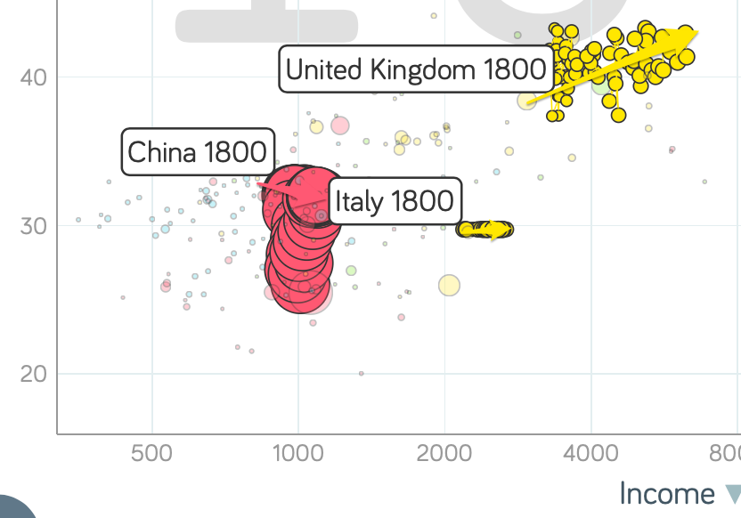
Global Divergence I
From 1500-1650 Europeans traveling to the high civilizations of Asia reported:
The princes and merchants were fabulously rich…
The people were prosperous and orderly
From 1650-1750:
The princes and merchants were fabulously rich…
The people were orderly
After 1750:
The princes were fabulously rich…
The people were destitute…
https://www.gapminder.org/tools

Slide 8
What Is to Be Explained?: Comparing Britain and the World
Britain in 800:
Population as under Roman Empire
$2/day (minus Roman conveniences)
Britain 800-1300: Civilization!
Britain 1300-1500:
Black Plague
Shifting to pasture
Britain 1500-1600:
Benefitting from Commercial Revolution
Textile Revolution
Agrarian techniques
Britain 1600-1770:
Empire and innovation
Britain 1770-1870:
Spread of industrialization

Slide 9
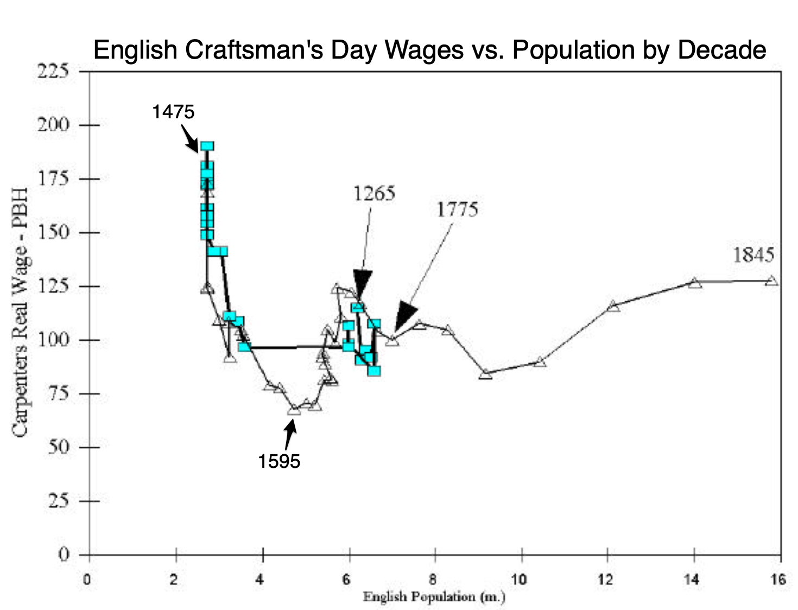
England Before 1850
1265-1345: High Middle Ages…
1355-1475: Bubonic Plague and socio-economic aftermath…
1475-1595: Malthusian Demographic Recovery…
1595-1775: Profits of Atlantic Seaborne Empire…
1775-1845: Demographic explosion, with little or no trickle-down…
John Stuart Mill (1848 and 1871): “It is questionable if all the mechanical inventions yet made have lightened the day's toil of any human being. They have enabled a greater population to live the same life of drudgery and imprisonment…”
http://faculty.econ.ucdavis.edu/faculty/gclark/papers/secret2001.pdf

Slide 10
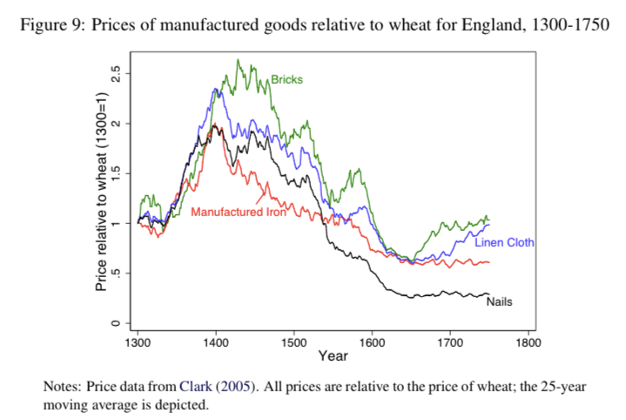
Huge Swings in Relative Price with Stable Technology

Slide 11
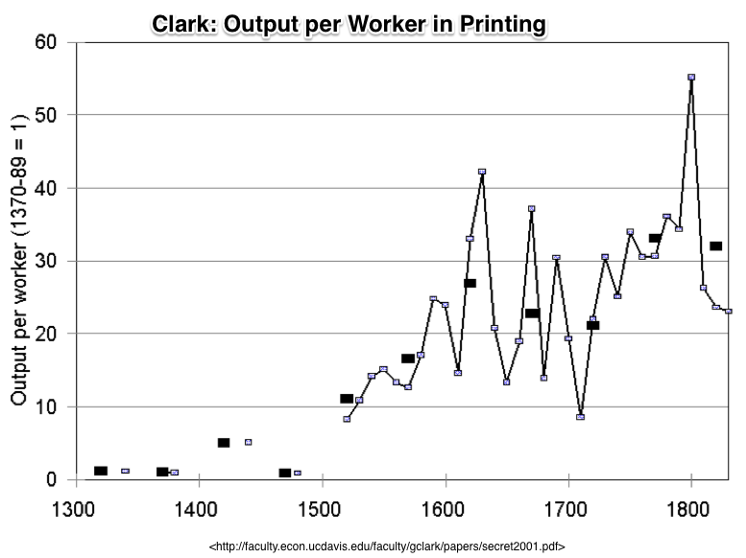
Compare to: Earlier “Industrial Revolution” in Printing Had No Direct Macro Impact…
A thirtyfold fall in the price of books from 1375 to 1775…
ln(30)/400 = 0.85%/year
But books are 1% of production…
So: 0.0085%/year
0.85%/century
3.4% over four centuries
That’s the direct effect…

Slide 12
Global Divergence II
Hans Rosling and Company: Gapminder Tools
1800-1870 sees:
UK go from $3430 to $6040
Italy go from $2220 to $2640
China go from $984 to $1100
From 1500-1700 Europeans traveling to the high civilizations of Asia reported general prosperity and order…
Not afterwards…
https://www.gapminder.org/tools

Slide 13
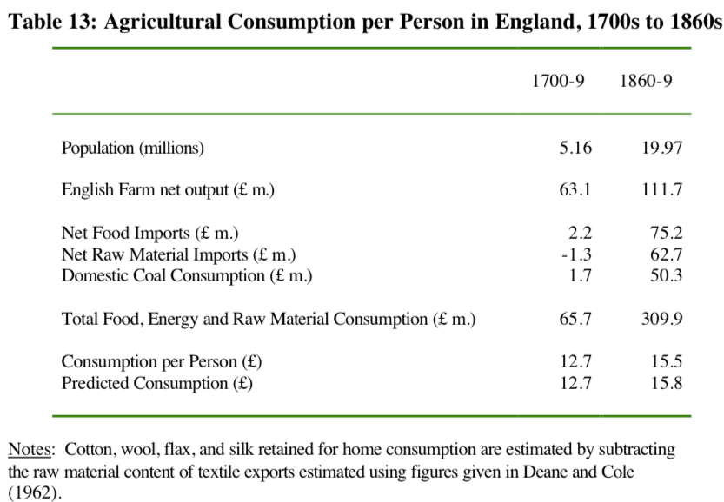
The Relocation of Global Industry to England
Clark: “The population fed and clothed by English agriculture did not expand from 7.5 million to 21 million between 1760 and 1860… from 7.5 to 9.6 million…”
Gets into the business of combining cotton, imported food, coal, and British and Irish workers to make the world’s textiles, iron, machines, and ‘protection’…
A huge shift…

Slide 14
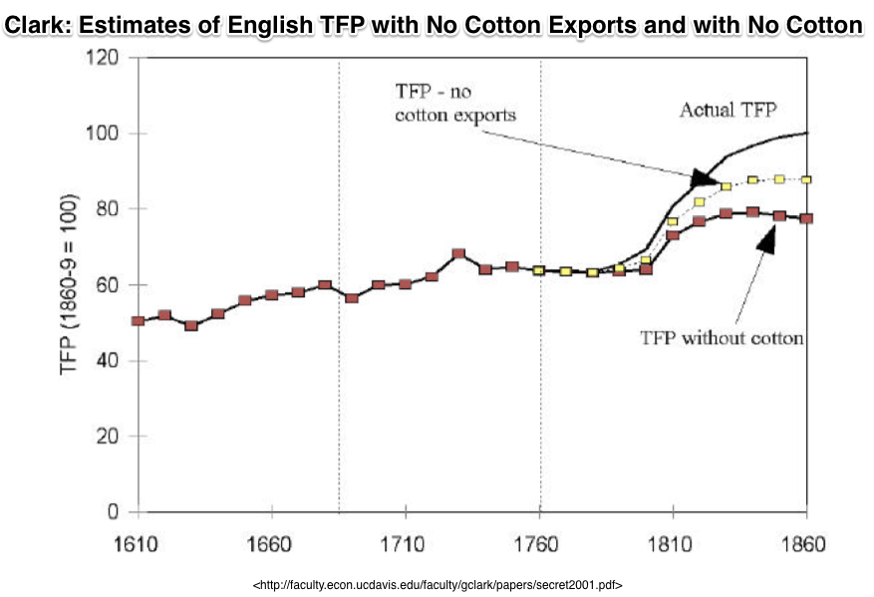
Cotton Is King! (Plus Iron and Steam)
The English ability to make clothes out of cotton in factories for domestic consumption was a 10%-of-everything gain by 1860…
The English ability to export cotton goods was another 10%-of-everything gain…
That’s 0.4%/year in a country growing its productivity level at 0.9%/year…
And iron and other steam are another 0.3%/year

Slide 15
Industrial Revolution I
NOT Merely a Continuation of What Was Going on in the Commercial Revolution Era:
Adam Smith had no clue of what was about to happen…,
Science…
Empire and commerce…
Coal…
“Institutions”
9:45-10:00

Slide 16
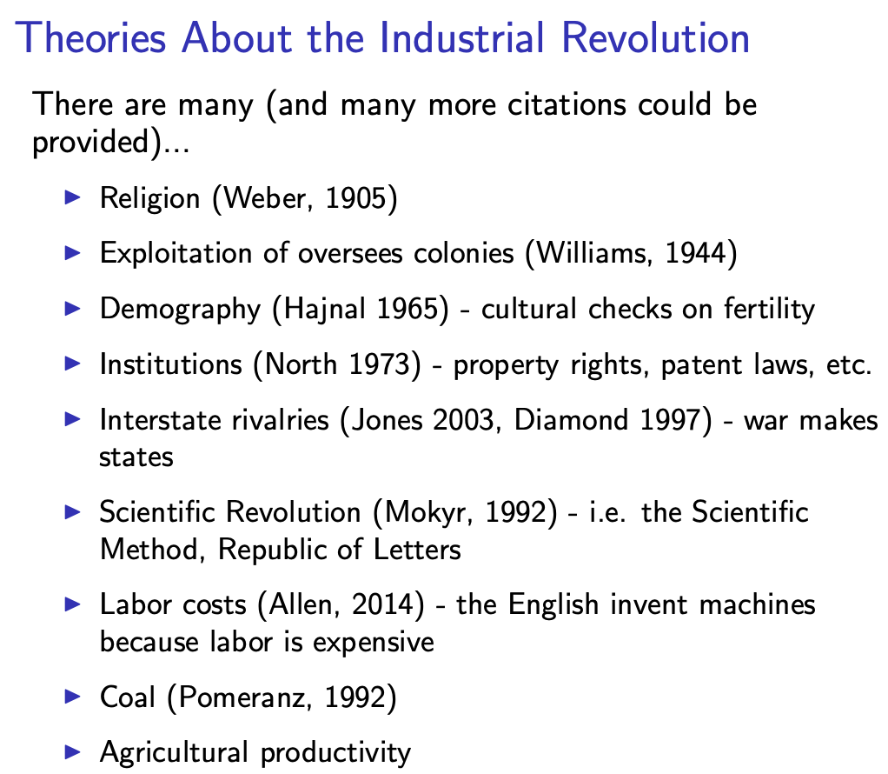
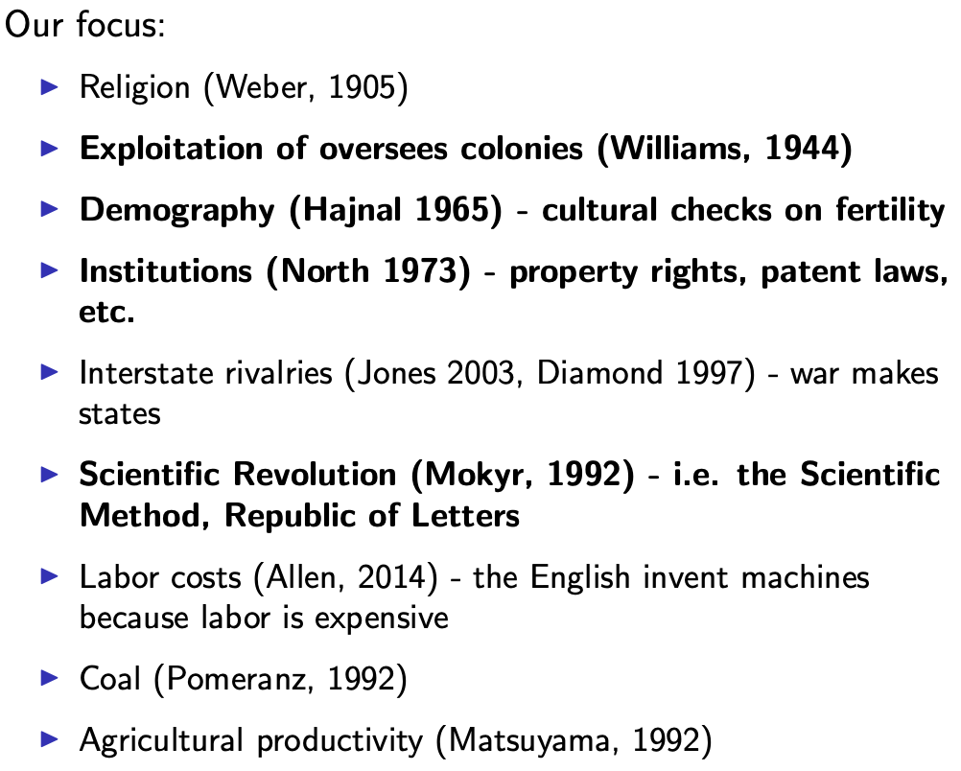
Many, Many Theories…
Slide taken from Melissa Dell

Slide 17
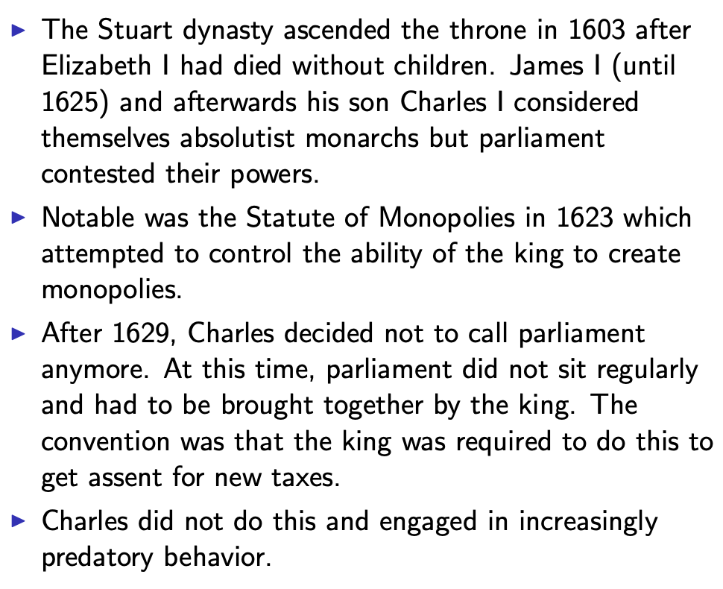
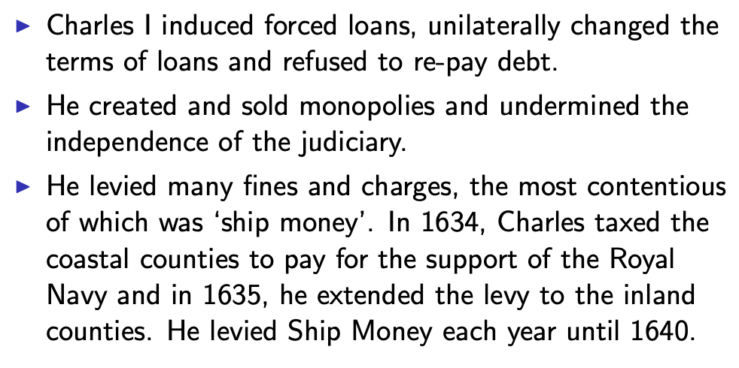
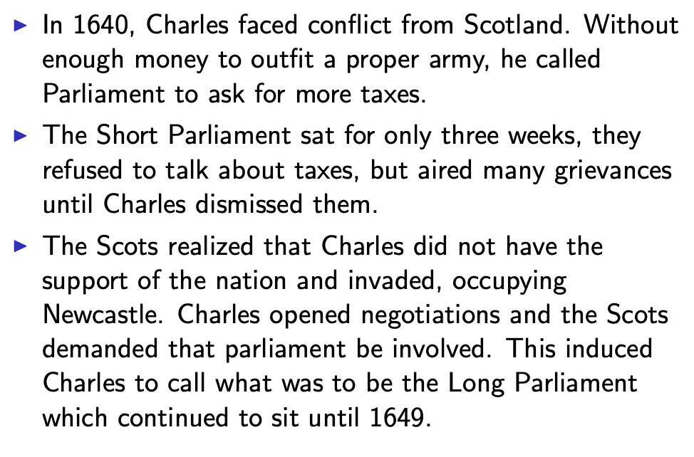
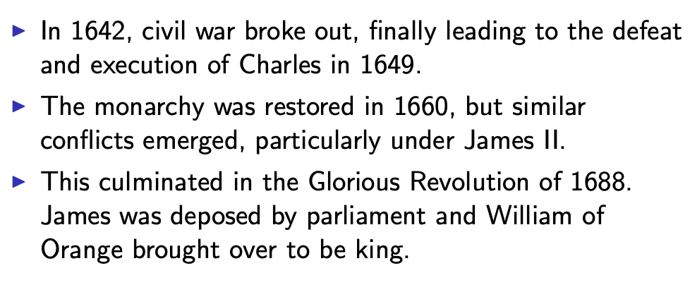
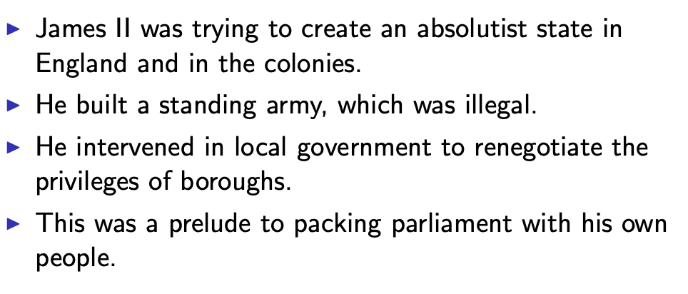
British Institutional Change
Slide taken from Melissa Dell

Slide 18
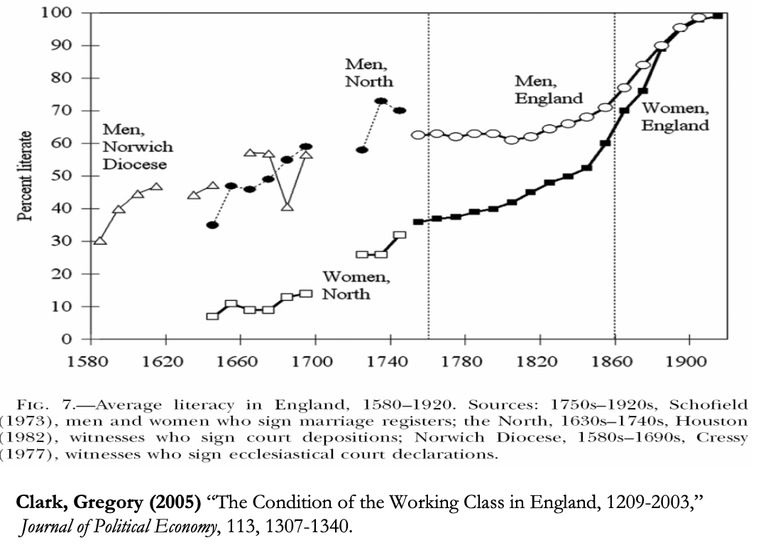
Literacy on the Advance
Slide taken from Melissa Dell

Slide 19
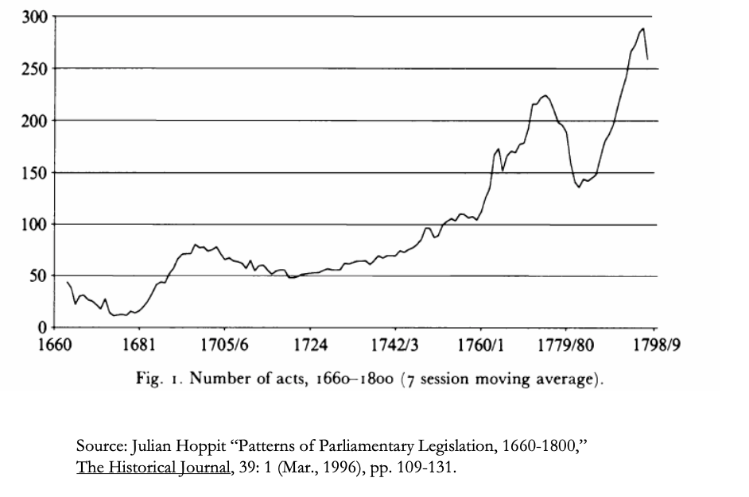
Amount of Parliamentary Legislation
Slide taken from Melissa Dell

Slide 20
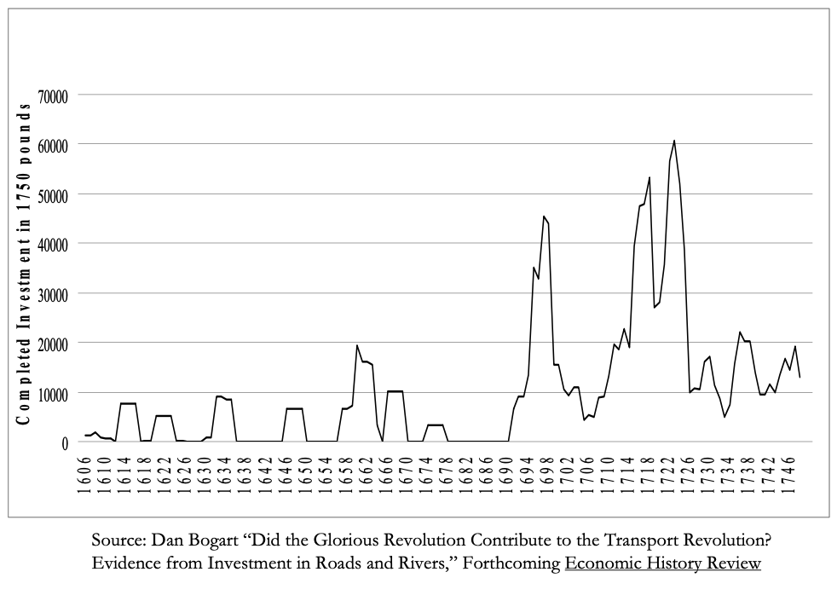
Investments in Road and River Transport
Slide taken from Melissa Dell

Slide 21
Making Policy and Making the State
The shift to Parliament made the government trustable by taxpayers:
The shift in authority and power to Parliament meant that policy got made in a completely different way.
Parliament was not a democracy (less than 10% of adult males voted, voting was open and elections were often uncontested), but the policymaking process was open to at least some segments of society.
This is revealed by petitioning, which was intense and often focused on economic policy, for example the attack on the Royal Africa Company or reorganization of property rights. Interestingly petitions were signed by many people who could not vote.
Finally, the Glorious Revolution led to a dramatic strengthening of the capacity of the state. This is brilliantly described by John Brewer in his book The Sinews of Power.
The taxation system was reorganized, with a huge expansion of the excise tax bureaucracy.
The bureaucracy was very modern in its structure and was not venal.
Government expenditures and debt expanded.
The main reason for this was to fund the navy. The navy fought wars but it also enforced the Navigation Acts, passed by Oliver Cromwell, which protected British industry.
Slide taken from Melissa Dell

Slide 22
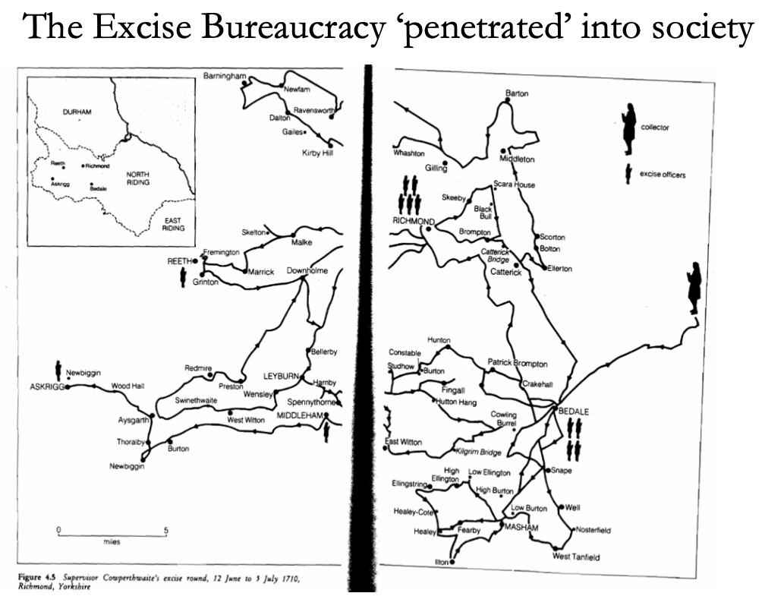
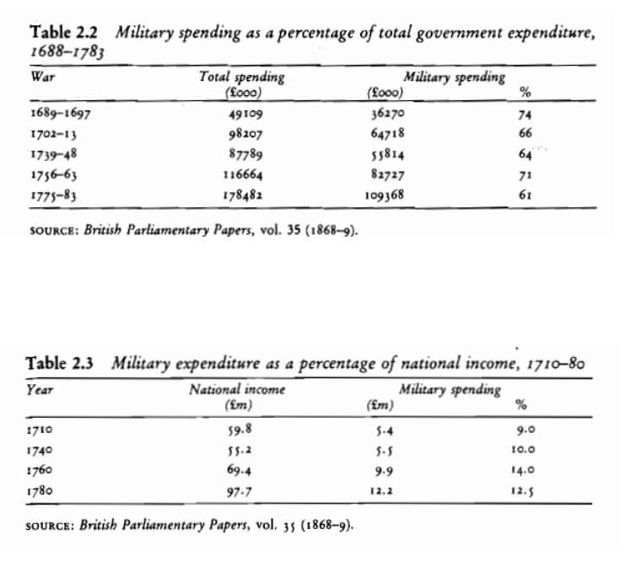
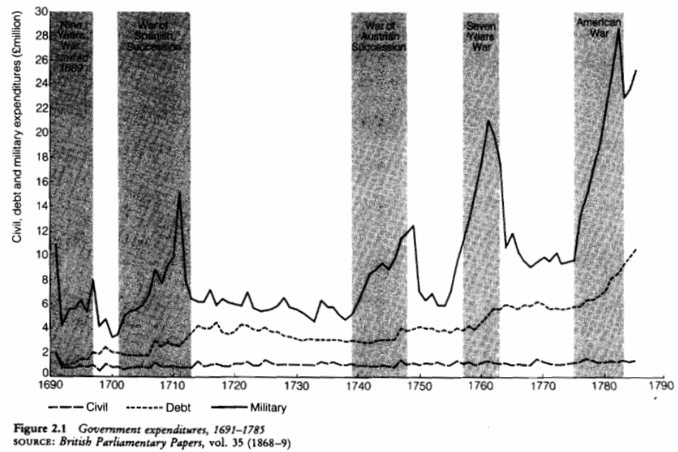
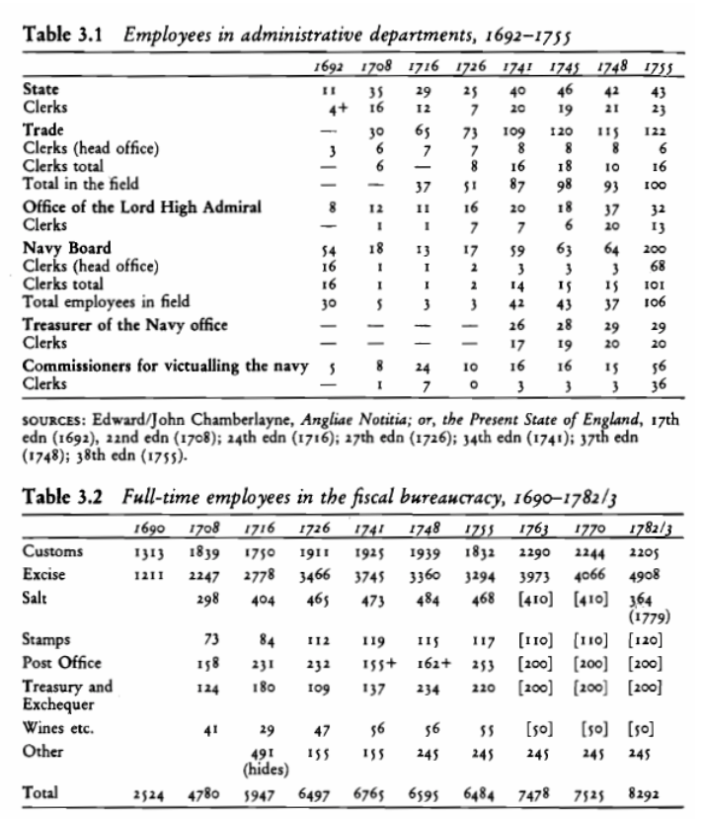
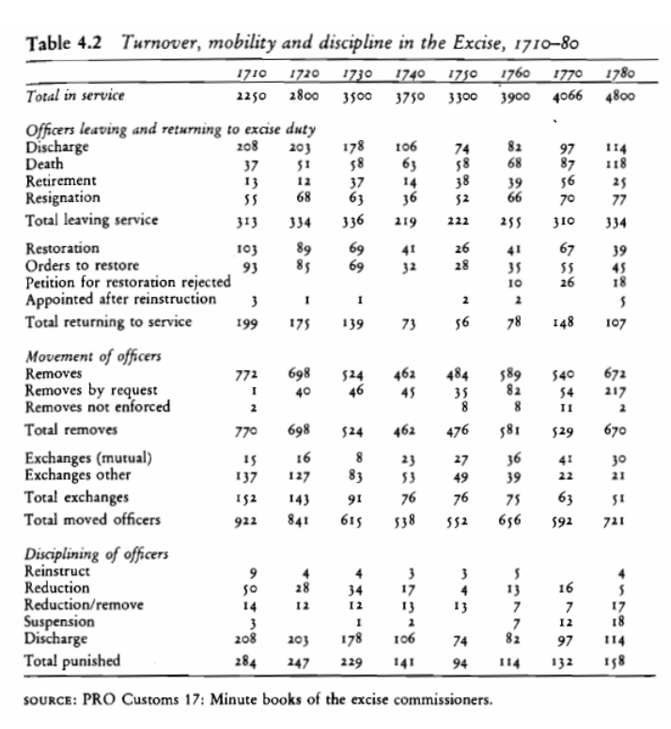
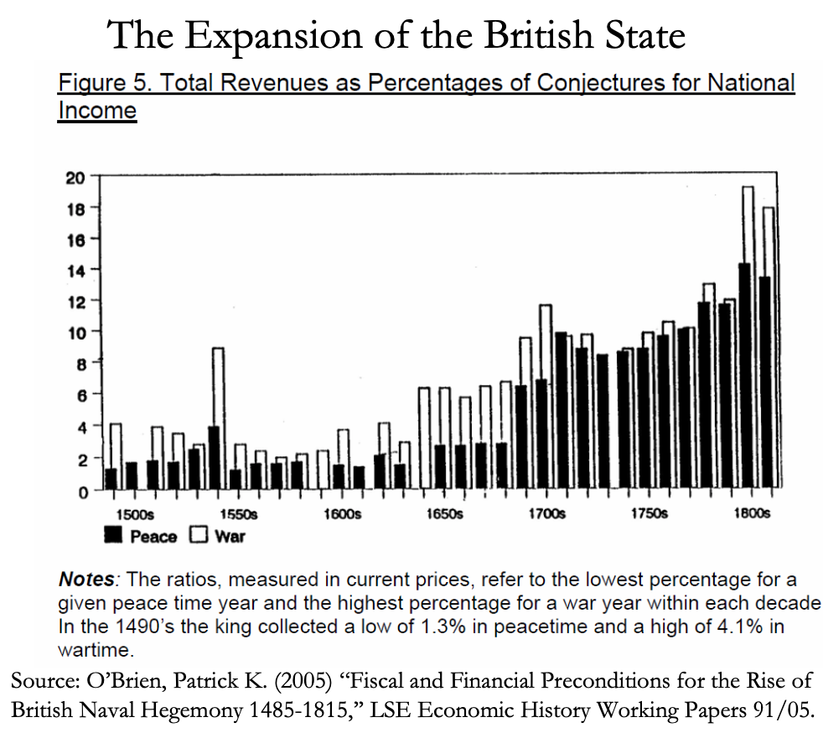
The Fiscal-Military State
Slide taken from Melissa Dell

Slide 23
Whigs and Hunters
In 1723 the Whig government passed the “Black Act” (in force until 1823) which made concealing your face a hanging offense:
In his book Whigs and Hunters: The Origin of the Black Act, E.P. Thompson shows that this was part of the struggle over the enclosure of common lands.
Poor people had traditional rights to pasture their cows, collect wood and wild foods etc, and these rights were taken away. In response they attacked the animals, crops, possessions of those who took the land and did so in disguise (like highwaymen).
On the face of it, the Black Act appears to be part of the strategy of the oligarchy to expropriate the poor after defeating the Monarchy. Thompson then asks: was the rule of law in England just a instrument of the oligarchy? A thinly disguised tool for their interests?
He shows the answer to this is no. Poor people challenged enclosures and frequently had their rights upheld by local justices of the peace, often the local squire or landowner! The rule of law was in fact real.
How can one explain this apparently paradoxical finding? Thompson argues that this stems from the struggle against the monarchy in the 17th century:
It was inherent in the very nature of the medium which they [those aristocrats, merchants etc. fighting the Crown] had selected for their own self-defense that it could not be reserved for the exclusive use only of their own class. The law, in its forms and traditions, entailed principles of equity and universality which ... had to be extended to all sorts and degrees of men. It is true that the law did mediate existent class relations to the advantage of the rulers, but it did so through legal forms, which imposed, again and again, inhibitions upon the actions of the rulers… (p. 264)
Slide taken from Melissa Dell

Slide 24
A Constrained Oligarchy
Law as a way for plutocracy to protect itself against kleptocracy:
The Oligarchy could not risk abandoning this situation because “in the sixteenth and seventeenth centuries the law had been less an instrument of class power than a central area of conflict. Inherited by the eighteenth century gentry, this changed law was .. central to their whole purchase upon power and upon the means of life. Take away law, and the royal prerogative .. might flood back upon their properties and lives.”
It was also in the interest of the king to constrain local elites by limiting their extraction of the peasants.
Thompson also points out an interesting connection to the transition towards democracy: “When the struggles of 1790-1832 signaled that this equilibrium had changed, the rulers of England were faced with alarming alternatives. They could either dispense with the rule of law, dismantle their elaborate constitutional structures, countermand their own rhetoric and rule by force; or they could submit to their own rules and surrender their hegemony.” (p. 269)
Slide taken from Melissa Dell

Slide 25
What Sort of Conflicts Happened in Britain?
Lots and lots of controversy…
There is a lot of controversy in the historical literature about the English Civil War and Glorious Revolution.
An earlier tradition emanating from Marx himself (and further advocated by Maurice Dobb and Eric Hobsbawm) saw these as ‘bourgeois revolutions’ where newly rising social classes overthrew existing regimes which were inimical to their interests.
But modern historians have poured cold water on this idea emphasizing a multitude of conflicts, particularly religious and regional, arguing that economic interests is not a good predictor of who was on the side of Parliament and who on the side of the King.
Robert Brenner’s important 1993 book Merchants and Revolution is an attempt to re-assert the empirical significance of the Marxist view. The seminal work however is 1688: The First Modern Revolution (2009) by Steven Pincus.
Slide taken from Melissa Dell

Slide 26
Economic Growth and Constitutional Regimes
Did it make a difference?
There is evidence that, though small compared to what happened subsequently, Western Europe began to pull ahead economically of the rest of the world in the early-modern period. Probably also significant in establishing the prerequisites for divergence.
Correlation between political reforms and success. Why did some countries develop constraints on power and constitutional regimes? Why did Spain not have a Glorious Revolution?
Acemoglu, Johnson, and Robinson examine this question in “Rise of Europe: Atlantic Trade” (American Economic Review, 2005).
We’ll see that the discussion here resonates with the debate between Brenner and Postan, and matters for interpretations of whether or not commercialization must have been good for institutional development.
Close aggregate association between growth and the expansion of overseas trade after 1492.
Slide taken from Melissa Dell

Slide 27
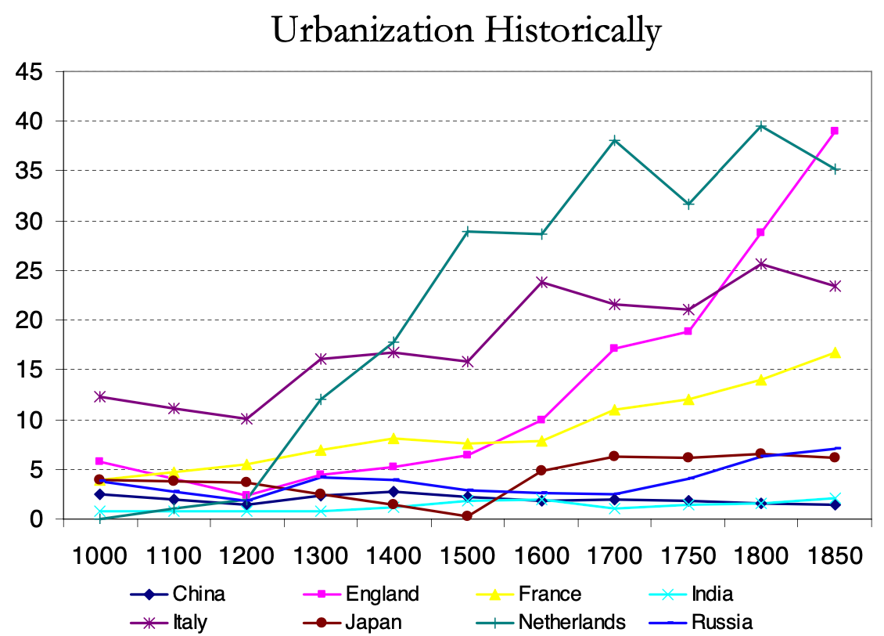
Urbanization as an Indicator of Prosperity
Slide taken from Melissa Dell

Slide 28
Industrial Revolution: Atlantic Expansion
Which countries developed constitutional regimes?
Major issue in early modern Europe: security of property rights for merchants and control of entry into overseas trade. These economic institutions determined by the distribution of political power.
In absolutist monarchies, less security of property rights and crown monopoly of foreign trade.
Development of constraints in Britain and the Netherlands related to conflict between merchants and Crown.
Institutional change driven by opening of Atlantic trade which enriched and empowered those with an interest in restraining power – English Civil War and Glorious Revolution, Dutch Revolt.
Thus rise of Western Europe was in fact the rise of Atlantic Europe. But not all Atlantic nations gained.
Changing environment: opening of trade routes to New World and Asia via the Atlantic.
Different effects of this new economic opportunity depending on economic and political institutions
In countries with access to the Atlantic and with some degree of entry into foreign trade (i.e., Britain and the Netherlands): new groups of merchants enriched.
In countries with tight crown monopoly of trade (i.e., Spain, Portugal, France), the monarchy and its allies became the main beneficiaries
For countries without access to the Atlantic; no direct benefits and indirect costs through diversion of trade
The enrichment of new groups outside of the Royal coalition was crucial. They had vested interest in more secure property rights and in restraining monopolies.
The enrichment of these groups through inter-Oceanic trade strengthened their resources and political power and culminated in the Dutch Revolt and in Britain the Civil War and Glorious Revolution.
Slide taken from Melissa Dell

Slide 29
Assessing the North-Thomas View
We now think it is incomplete:
North and Thomas’ view incomplete. They do not explain why this all happened in Britain. North and Thomas argued that this was due to initially good institutions (Tudor monarchy in England was relatively constrained already), but this is not sufficient to explain who did well (e.g. Italian city states had best institutions but stagnated).
Crucial interaction between initial institutions and access to Atlantic/Overseas trading opportunities.
In fact, while in Britain and the Netherlands trade went hand in hand with improvements of institutions, in Spain there was institutional decline.
This is very much like Brenner’s story. It is the initial institutions (balance of power in society) that determines the implications of a big trade shock.
Slide taken from Melissa Dell

Slide 30
The European Marriage Pattern and European Growth
Malthus: positive and preventative checks:
Positive checks: events that raised the death rate, such as famines, disease, and war. We discussed that these may occur as rising population puts downward pressure on wages.
Preventative checks: behavior that lowered the fertility rate - delaying the age of marriage for women or preventing some women from marrying altogether.
Societies where the positive check operates have a low level of average income since population expansion is only restrained by mortality.
Societies where the preventive check operates have a higher level of average income since the birth rate falls if income drops and the fall in fertility relieves the population pressure, thereby, cushioning the income drop.
In Bulgaria in 1900,all women (99%)eventually married and most married in their teens.
Bulgaria was a positive check society
CBR was very high and independent of income.
In Belgium in 1900, 17% of the women never married and most who did married late.
Belgium was a preventive check society.
CBR was lowered and could rise and fall with the income as marriage ages and proportions changed.
Slide taken from Melissa Dell

Slide 31
A Line from Trieste on the Adriatic to Stettin on the Baltic Divides Continental Europe
Preventative checks west; positive checks east:
Western Europe was distinctive:
It had a preventive check demographic system.
Birth and death rates were lower.
The standard of living was always higher.
The higher standard of living could have provided more scope for savings and investment, allowing western Europe’s lead grew over time.
Hence, Hajnal argued that distinctive family structure could explain the rise of the Western world.
But:
Research on Asia - such as the seminal work by Ken Pomeranz that we will discuss later in this lecture - has brought this view into question.
A variety of historical evidence shows that in China, high rates of female infanticide were used as a preventative check on fertility.
It was not uncommon for female infanticide rates to be as high as one third, and infanticide appears to have responded to economic conditions.
If the European marriage pattern was a necessary condition for the Industrial Revolution, it could not have been a sufficient condition.
Slide taken from Melissa Dell

Slide 32
The Scientific Revolution
A culture of inquiry, and the disenchantment of the world:
Mokyr 2002 (p.29): “the true key to the timing of the Industrial Revolution has to be sought in the scientific revolution of the 17th century and the Enlightenment movement of the 18th century. The key to the Industrial Revolution was technology, and technology is knowledge.”
Scientific Revolution: works of Galileo, Newton, Leibniz et al.
Francis Bacon (1561 - 1626): An English philosopher, orator, and statesman, who is also held to be the father of modern empiricism. His works argue for scientific knowledge based only upon inductive and careful observation of events in nature.
Robert Boyle (1627 - 1691): An Anglo-Irish scientist who is widely regarded to be the first modern chemist and the father of modern chemistry. He is known for carrying out the principals that Bacon developed.
The steam engine was invented by Newcomen (1711) and Watt (1765). It required two prior scientific discoveries:
􏰀 Understanding of atmospheric pressure
􏰀 Understanding that the condensation of steam creates a vacuum (Torricelli and von Guericke)
Chlorine bleaching depended on the prior discovery of chlorine by the Swedish chemist Scheele in 1774
Slide taken from Melissa Dell

Slide 33
How Much Did the Scientific Revolution Matter?
Links between scientists and technology on the ground were often tenuous
There are many other cases where the Scientific Revolution did not play a role in technological innovation: most notably cotton textiles and iron smelting
Concepts were first used and only later understood. Many advances may have been discovered by accident, reminiscent of the cultural learning that we learned about earlier in the semester.
Literacy rates grew only modestly during the Industrial Revolution (Mitch 1998)
Learning by doing:
Increase in furnace height and blast temperature 1850-1875
This was important for productivity growth in English iron and steel
There was not a theory of the blast furnace
It is an example of collective invention
Scientific Revolution was pan-European, whereas Industrial Revolution was largely British.
Did 17th/18th century research generate useful knowledge?
Slide taken from Melissa Dell

Slide 34
Difference Between First and Second Industrial Revolution
1850 is a watershed here:
Astronomy, botany, crystallography, early exploration of magnetism, refraction of light, combustion: advances in these fields had no impact on cotton textiles, mining, iron melting and refining
All this changes with the 2nd Industrial Revolution ca. 1860 - 1900
Bessemer steelmaking process (1856), chemicals, electricity, fertilizer, automobiles
No 2nd Industrial Revolution without the Scientific Revolution: for instance, the telegraph (magnetism and electricity)
Innovation becomes much more closely tied to universities
Slide taken from Melissa Dell

Slide 35
Industrial Revolution Theories: Summing Up
A still-ongoing debate:
Proponents of the scientific revolution and institutions views can - and do - debate at length the quantitative importance of the Scientific Revolution.
How many industries did it matter for? Given that it didn’t likely matter directly for some of the most important industries, could the culture created by the Enlightenment matter?
These are very hard things to measure.
Similar arguments can be made about the institutions view - how different in practice were English institutions from those found elsewhere?
Ultimately, both institutions and the Scientific Revolution were probably important (and related), as may have been some of the other explanations outlined above.
We can think of the beginning of sustained modern growth as a very unlikely event that - so to say - required all the holes in many pieces of Swiss cheese to align. Things oftentimes can go wrong many more ways than they can go right (entropy).
Slide taken from Melissa Dell

Slide 36
Fundamental Explanations of the Industrial Revolution: Examples
Institutions: the Glorious Revolution led to the development of property rights and other institutions favoring growth.
Culture: differences in fertility regimes, marriage norms, religion, or attitudes towards scientific discovery made growth happen first in Western Europe.
Geography: the Industrial Revolution happened first in Britain because it had rich coal deposits, or extensive access to the Atlantic.
International factors: Britain was able to industrialize first because it benefited most from the slave trade.
Luck plus increasing returns: Britain hit the jackpot in discovering a few key inventions that in turn led to more technological progress.
Slide taken from Melissa Dell

Slide 37
Review: What Should We Review Today?
A number of possibilities:
Essay…
Practice:
Fair:
The grand overview of the history of economic growth
Models:
The Solow growth model
Malthusian forces
“Two heads (almost) twice as good as one” & “low-hanging fruit is picked first” & “institutions matter a lot”
Malthusian economics
& “class power”
Measuring prosperity relative to “subsistence”
Ancient empires (& their rise & fall)
10:00-10:10

Slide 38
Industrial Revolution: Coal and Wages
Robert C. Allen:Why the Industrial Revolution Was British
Britain had a unique wage and price structure in the eighteenth century, and that structure is a key to explaining the inventions of the industrial revolution.
British wages were very high by international standards, and energy was very cheap.
This configuration led British firms to invent technologies that substituted capital and energy for labour.
High wages also increased the supply of technology by enabling British people to acquire education and training.
Britain’s wage and price structure was the result of the country’s success in international trade, and that owed much to mercantilism and imperialism.
When technology was first invented, it was only profitable to use it in Britain.
Eventually it was improved enough that it became cost-effective abroad. When the ‘tipping point’ occurred, foreign countries adopted the technology in its most advanced form…”
10:00-10:10

Slide 39
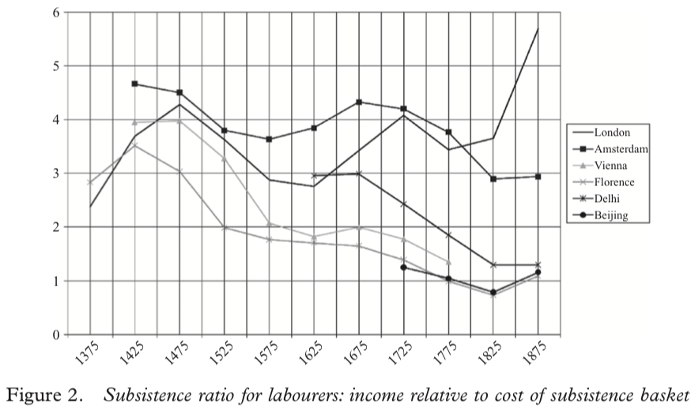
“Subsistence Basket” Wages
But this is an input rather than an output to the process of generating modern economic growth…

Slide 40
Robert Allen: Rule, Brittania!
Britain had uniquely high real wages
Why? Northwest European marriage pattern?
Why? Yeoman smallholder legacy of the Bubonic Plague?
Why? The British navy and the British empire and the fiscal-military state?

Slide 41
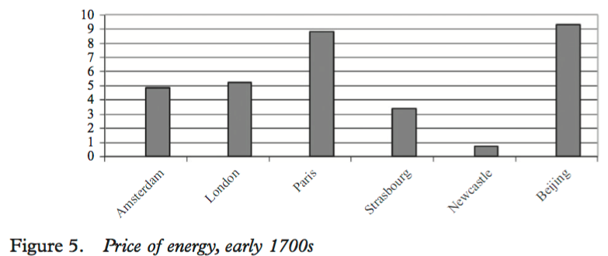
Rule, Brittania! II
Britain—not London so much as Newcastle, and Manchester—had a uniquely cheap real price of energy
Why? Coal at the surface?
Why? Coal on navigable water?
Why? Wet coal mines?
Only in Britain would the first generation of steam engines be both (a) useful and (b) profitable
Eighteenth-century Lancashire the only escape from Malthusian agrarian poverty

Slide 42
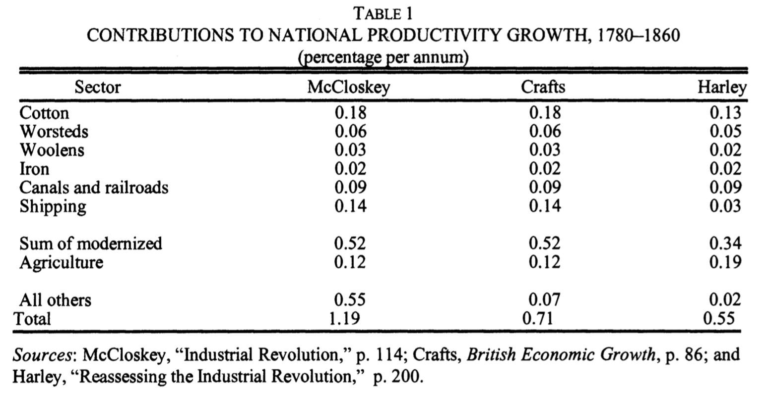
Two Views of the British Industrial Revolution
Peter Temin. 1997, “Two Views of the British Industrial Revolution,” Journal of Economic History 57 (March), pp.63–82. www.jstor.org/stable/pdfplus/2951107.pdf . The Issue:

Slide 43
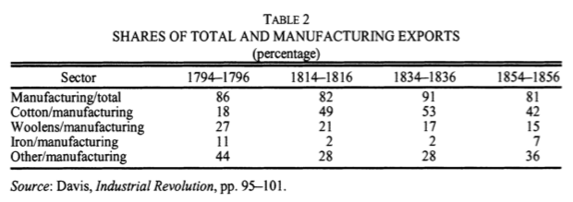
Two Views of the British Industrial Revolution
Peter Temin. 1997, “Two Views of the British Industrial Revolution,” Journal of Economic History 57 (March), pp.63–82. www.jstor.org/stable/pdfplus/2951107.pdf

Slide 44
Two Views of the British Industrial Revolution
“There was, as noted for exports in Table 4, little variation in the composition of British imports over the first half of the nineteenth century….
“Britain maintained a clear comparative advantage in a wide variety of manufacturing industries throughout the first half of the nineteenth century. They held their own in the face of the spectacular growth of cotton-textile exports during those years. There is no hint that these other commodities were being pushed off the list of exports by the growth of cotton exports….
“There is an exception that proves the rule… watches and clocks. As Landes noted in his book on that industry, the English clockmakers and watchmakers were falling behind their continental competitors in the nineteenth century. Productivity stagnated in this industry, and it had become an import industry by midcentury.
“The export of most other manufactures, however, was continuing merrily along. The lesson of the constant rank order of these exports is that the various industries were keeping pace with each other…”

Slide 45
Two Views of the British Industrial Revolution
Temin seeks to investigate whether the “narrow front“ coal and steam and textiles and iron interpretation of the British Industrial Revolution fits the historical facts better or worse than the “broad front“ innovative society and economy interpretation.
Temin aims to use the Ricardian theory of trade and revealed comparative advantage To shed insights into changes in industry-level productivity over the course of the Industrial Revolution.
He finds essentially no change in the set of commodities that Britain exports and imports across the Industrial Revolution.
He claims that this decisively answers the question in favor of the “broad front” interpretation.

Slide 46
Two Views of the British Industrial Revolution
Why might he be wrong?

Slide 47
Two Views of the British Industrial Revolution
Why might he be wrong?
Capital outflows…
Improvements abroad in agriculture etc.
Changes in relative prices…
Especially cotton...

Slide 48
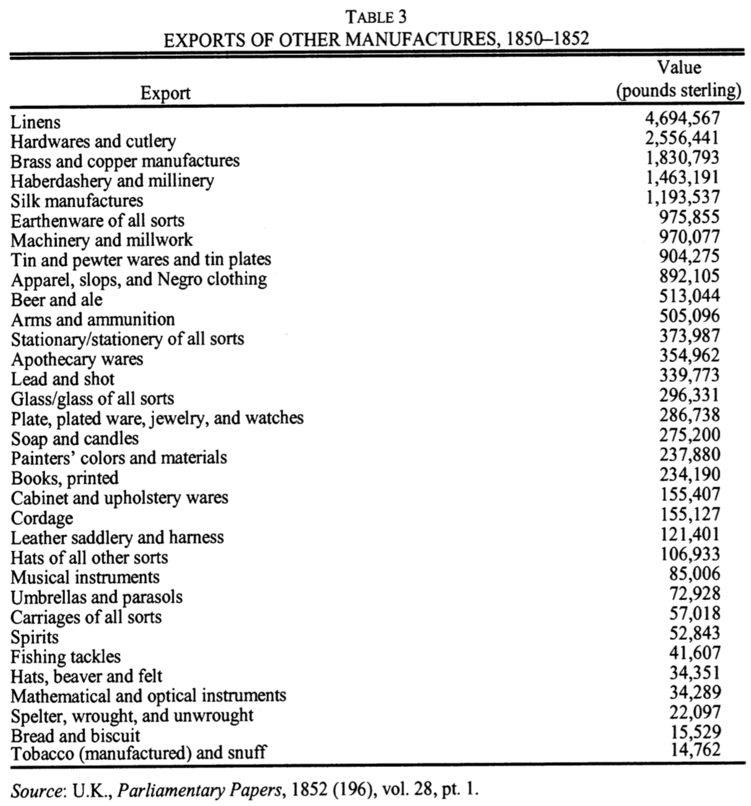
Two Views of the British Industrial Revolution

Slide 49
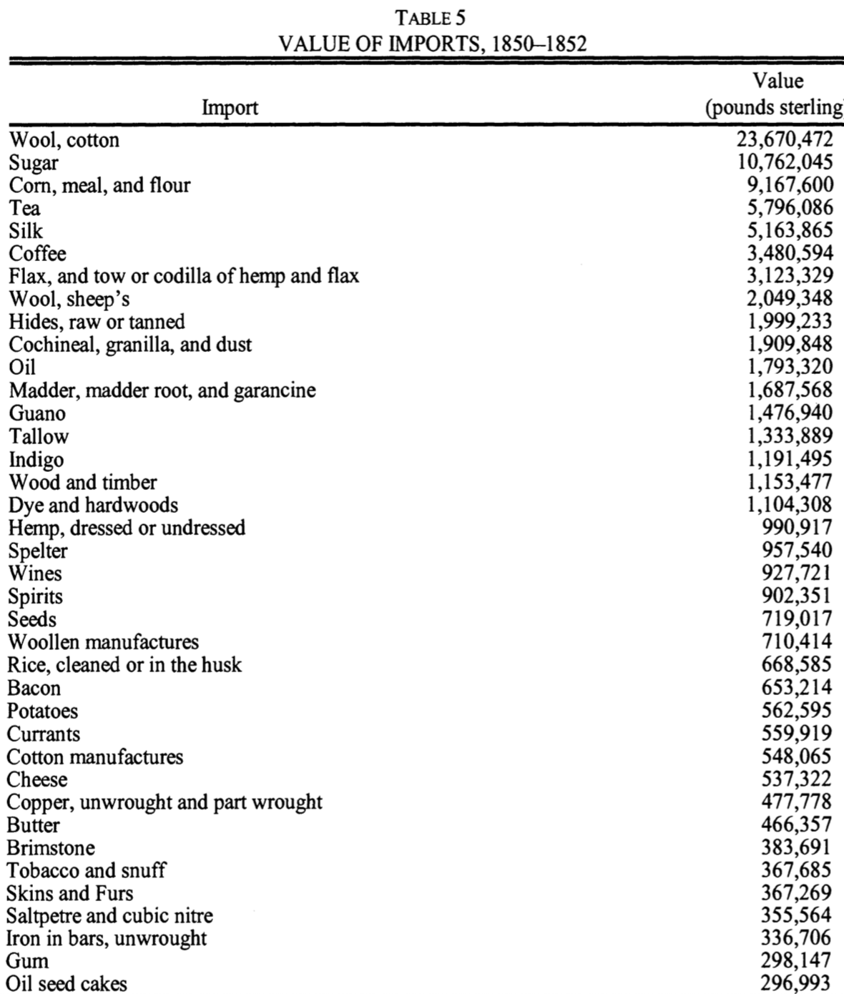
Two Views of the British Industrial Revolution

Slide 50
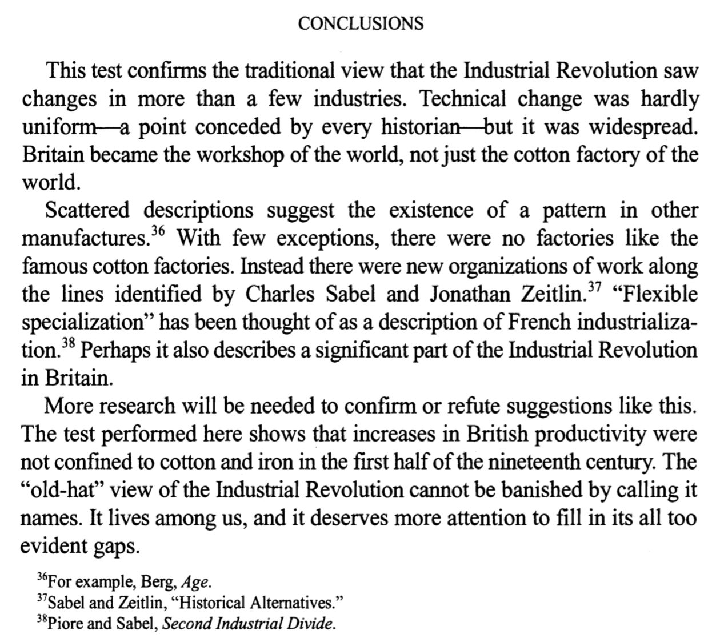
Two Views of the British Industrial Revolution

Slide 51
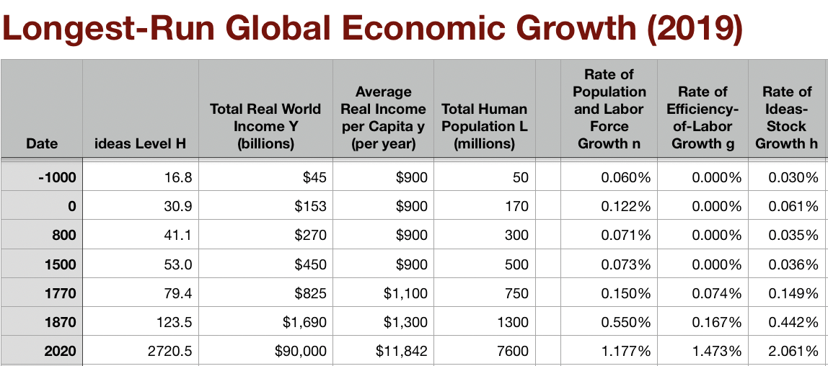
Discussion
The Industrial Revolution:
The
10:35-10:50

Slide 52
Big Ideas: Lecture 9: Industrial Revolution
Takeaways from this lecture:
OK: What should the takeaways from this lecture be?
10:50-10:55

Slide 53
Preview of Lecture 10: Industrial Revolutions II
What I hope we will cover:
The
10:55-11:00

Slide 54
Catch Our Breath…
Ask a couple of questions?
Make a couple of comments?
Any more readings to recommend?

Slide 55
Notes

Slide 56
Reviews…

Slide 57
Review: Commercial Revolutions
Exploration and Conquest and Market Extension:
Zheng He: 1405-33: 7 expeditions—300 ships ??, 30,000 crew??, as far as Malindi. 400 feet long??:
“We have traversed more than 100,000 li of immense water spaces and have beheld in the ocean huge waves like mountains rising in the sky, and we have set eyes on barbarian regions far away hidden in a blue transparency of light vapors, while our sails, loftily unfurled like clouds day and night, continued their course [as rapidly] as a star, traversing those savage waves as if we were treading a public thoroughfare…”, quoted in Louise Levathes (1996): When China Ruled the Seas: The Treasure Fleet of the Dragon Throne, 1405–1433
Bartolomeu Dias: 1487-8: 3 ships, rounded the Cape of Good Hope at the southern tip of Africa. 80 feet long, 30 men/ship
Cristoforo Colombo: 1492: 3 ships, 90 men.
Vasco da Gama: 1498: 4 ships, 170 men to India and back
9:45-10:00

Slide 58
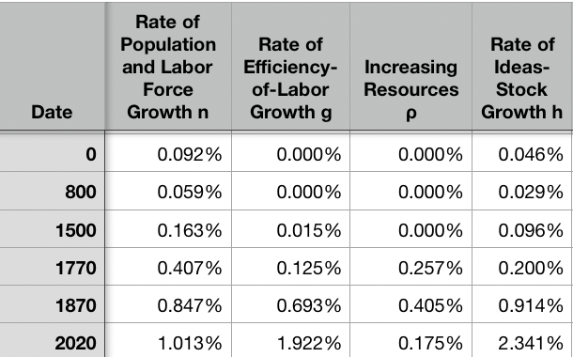
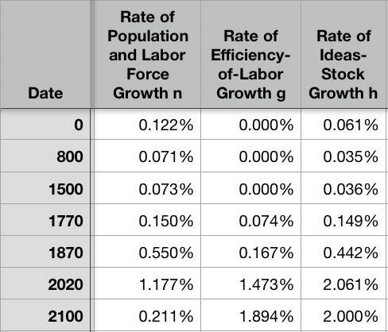
Resources! And Political Economy!
“The Advanced West”
The Columbian Exchange
Corn, the potato, chocolate, &c.: substantial boost to calories
Benefits everywhere!
But one-sided: Europe gains empire and resources wherever its ships can sail and cannon can shoot
Sugar islands and the slave trade
400 calories per Briton per day by 1750?
The underdevelopment of Africa
12.5 million Atlantic African slave trade
(2 million Mediterranean, 4 million Black Sea, 1 million Viking, 17 million Indian Ocean, 30 million Graeco-Roman)
The East Indies
Spices—later silks, porcelain, cottons: 80% fall in real price
Benefits everywhere
But benefits one-sided: disassembling a mountain of silver in Peru in order to import luxuries from China, India, Malaysia, and Indonesia…
Political Economy
The merchants of Bristol, the nabobs, the King of Spain: New wealth to add in to the scales…
Inflation
The World
9:45-10:00

Slide 59
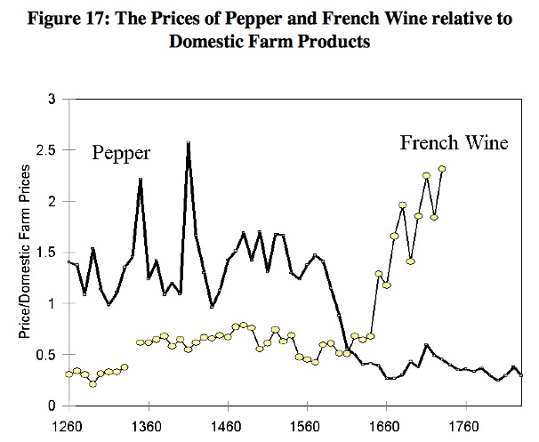
Clark, “The Secret History of the Industrial Revolution”
9:45-10:00

Slide 60
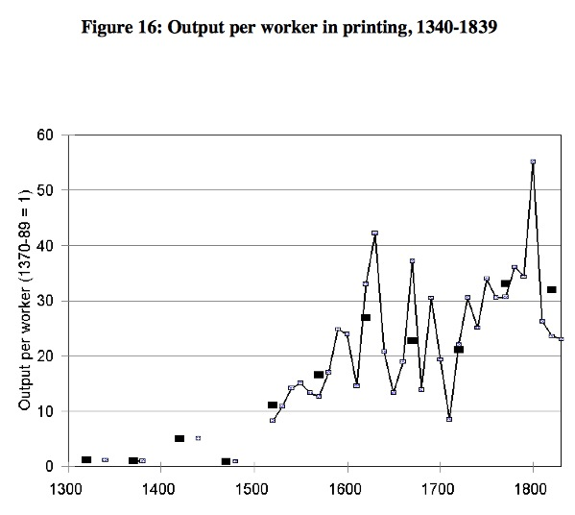
Clark, “The Secret History of the Industrial Revolution”
9:45-10:00

Slide 61
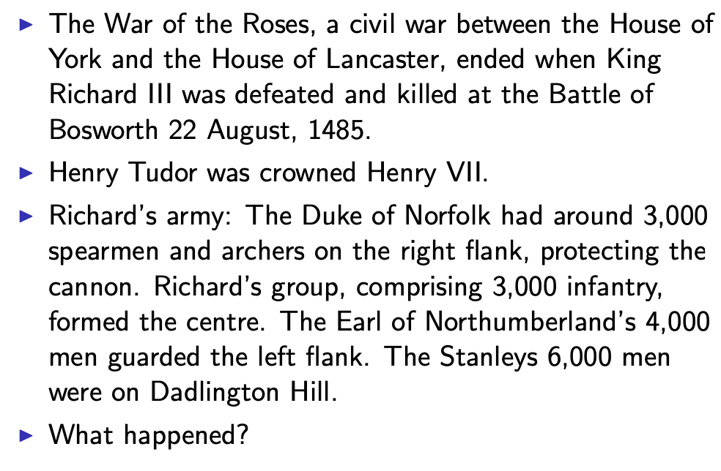
Establishing an Effective Monopoly of Violence: Wars of the Roses
10:10-10:20
Slide taken from Melissa Dell

Slide 62
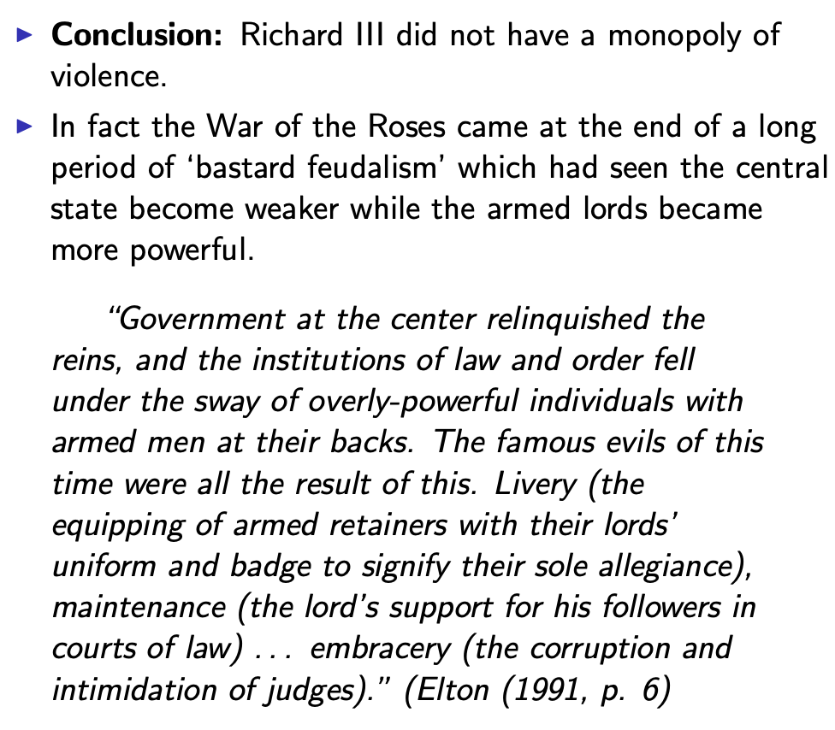
Establishing an Effective Monopoly of Violence: Implications of the Treason of the Stanleys
10:10-10:20
Slide taken from Melissa Dell

Slide 63
Marcher Lords: Warwick the Kingmaker
Adam Smith: “The great Earl of Warwick is said to have entertained every day, at his different manors, 30,000 people; and though the number here may have been exaggerated, it must, however, have been very great to admit of such exaggeration. A hospitality nearly of the same kind was exercised not many years ago in many different parts of the Highlands of Scotland…
10:10-10:20

Slide 64
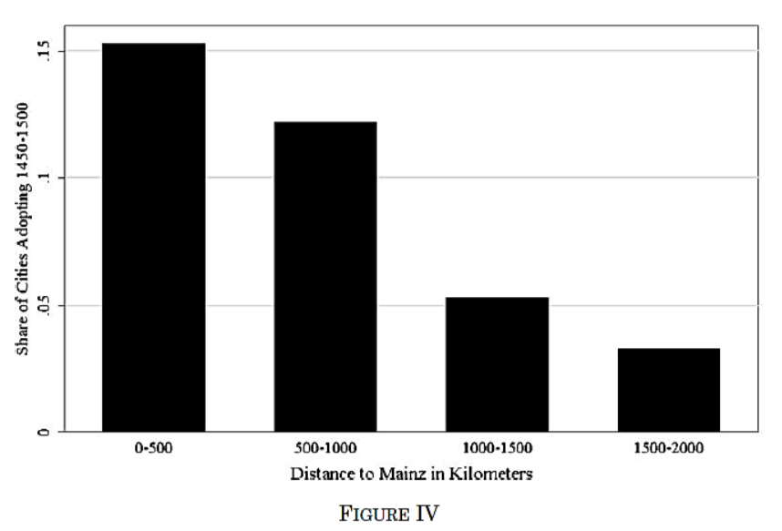
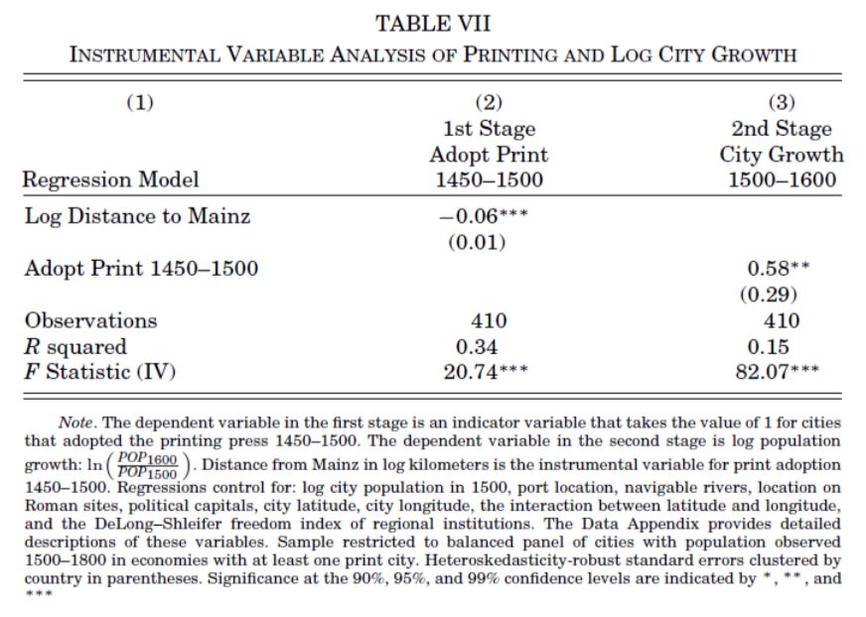
Jeremiah Dittmar (2011): The Printing Press as an Agent of Change… II
Dittmar’s Test: Compare (especially over the period 1500– 1600) population growth of cities that did and did not adopt the printing press before 1500.
Why are DIttmar’s IV estimates so big? 0.6 per century—a near doubling—as opposed to 0.2?
10:10-10:20

Slide 65
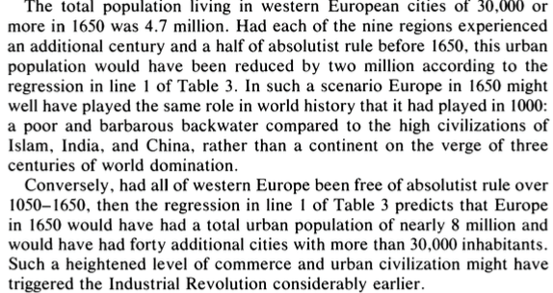
DeLong and Shleifer I
It’s a big deal…
10:10-10:20

Slide 66
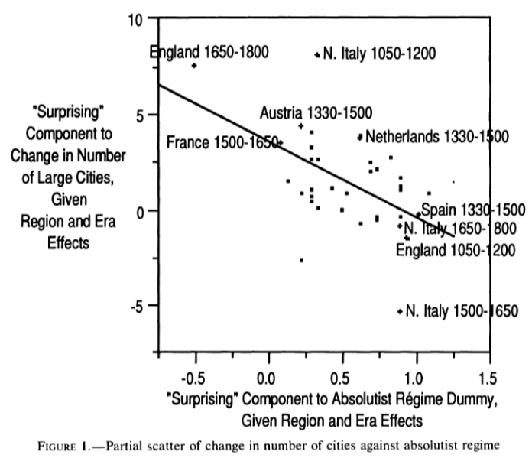
DeLong and Shleifer III
Northern Italy in 1500-1650 is “surprising” as absolutist then
England 1650-1800 is “surprising” as non-absolutist then
WTF?! with the Italian urban boom 1050-1200
Econometric problems
Normal distribution—we have only 45 observations, and 30 degrees of freedom…
The file-drawer problem…
10:10-10:20

Slide 67
Discussion
“Commercial Society” of the Eighteenth Century
An extra 1500 years of invention and innovation, yes…
Scope of control…
Columbian Exchange…
But, otherwise, how different from Antonine Rome or Sung China or Abbasid Mesopotamia?
It did occur in Antonine Rome…
Temin: no industrial revolution…
10:35-10:50

Slide 68
Review: Adam Smith
We Have a Very Keen-Eyed Contemporary Observer:
Read: Christopher Berry (2018): Adam Smith: A Very Short Introduction, chs. 1, 4-6 <https://delong.typepad.com/files/berry-smith.pdf>
The market economy as a game changer
Commercial society:
Hunter, shepherd, agricultural, and commercial stages…
“It is Smith’s explicit reference to a ‘commercial society’ that is distinctive and Smith here is a pioneer…”
Agrarian-Age power lies with the owners of land, and government is ‘a combination of the rich to oppress the poor’
Commercial society sees the growth of the rule of law—and a government that can enforce its property-rights order against local notables, roving bandits, and its own functionaries…
10:15-10:35

Slide 69
Why the Emergence of “Commercial Society”
Friedrich Engels:
“Exceptional periods, however, occur when the warring classes are so nearly equal in forces that the state power, as apparent mediator, acquires for the moment a certain independence in relation to both. This applies to the absolute monarchy of the seventeenth and eighteenth centuries, which balances the nobility and the bourgeoisie against one another; and to the Bonapartism of the First and particularly of the Second French Empire, which played off the proletariat against the bourgeoisie and the bourgeoisie against the proletariat. The latest achievement in this line, in which ruler and ruled look equally comic, is the new German Empire of the Bismarckian nation; here the capitalists and the workers are balanced against one another and both of them fleeced for the benefit of the decayed Prussian cabbage lords…” Origin of the Family…
It was in the kings’ and their bureaucracies’ interests—and they were (sometimes) able to make it stick.
10:15-10:35

Slide 70
Why the Emergence of “Commercial Society” II
Adam Smith, according to Berry:
“The feudal lords were masters… settled disputes, enforced discipline, and commanded their tenants to fight on their behalf….. [But] when foreign commerce introduced… what Smith deliberately calls frivolous and useless goods (he mentions diamond buckles) the lords sold off their land or granted long leases… undermine[d] their power to command and their ability to act as judges because those who had been previously dependent became independent: ‘For the gratification of the most childish, the meanest and the most sordid of all vanities’… these landlords gradually bartered away their whole power and authority (WN 419)…
“Smith calls this change a ‘revolution of the greatest importance to the publick happiness’ (WN 422)
But it was not brought about with the deliberate aim to further the public good…
It was, rather, an example of unintended consequences.
This made possible the ‘regular administration of justice’.
The establishment of that uniformity is crucial
Without it a commercial society is not possible
10:15-10:35

Slide 71
Once You Have the Preconditions for “Commercial Society”…
Commercial Revolution Prosperity:
“Universal opulence which extends itself to the lowest ranks of the people…”
Because of the division of labor…
Possible only in a well-governed society…
Berry: “Through the division of labour ten individuals could make 48,000 pins a day—equivalent to 4,800 each. But if each individual performed all the tasks required (drawing, straightening, cutting, pointing the wire, and so on) then less than twenty would have been manufactured. He gives three reasons for this: increased dexterity that comes from reducing each individual’s task to ‘one simple operation’; time-saving that stems from not having to transfer from one task to the next; and inventing better ways of executing the task prompted by the concentration on one task…”
Division of labor depends on the extent of the market…
And self-interest: “it is not from the benevolence of the butcher, the brewer or the baker that we expect our dinner, but from their regard to their own interest. We address ourselves not to their humanity but to their self- love and never talk to them of our own necessities but of their advantages. Nobody but a beggar chuses to depend chiefly upon the benevolence of his fellow-citizens…”
10:15-10:35

Slide 72

Smith’s “System of Natural Liberty”
Depends on Universal Principles: Smith according to Berry:
A ‘science of human nature’.
The self-interested hope of everyone to better their own condition.
The moral principle that everyone is free.
Individuals are the best judges of their own interests
The outcomes of particular exchanges redound unintentionally to the general benefit.
The ‘miserable poverty’ of the savage nations, as depicted in his Introduction, is left behind
The twin blessings of opulence and freedom are experienced.
10:15-10:35

Slide 73
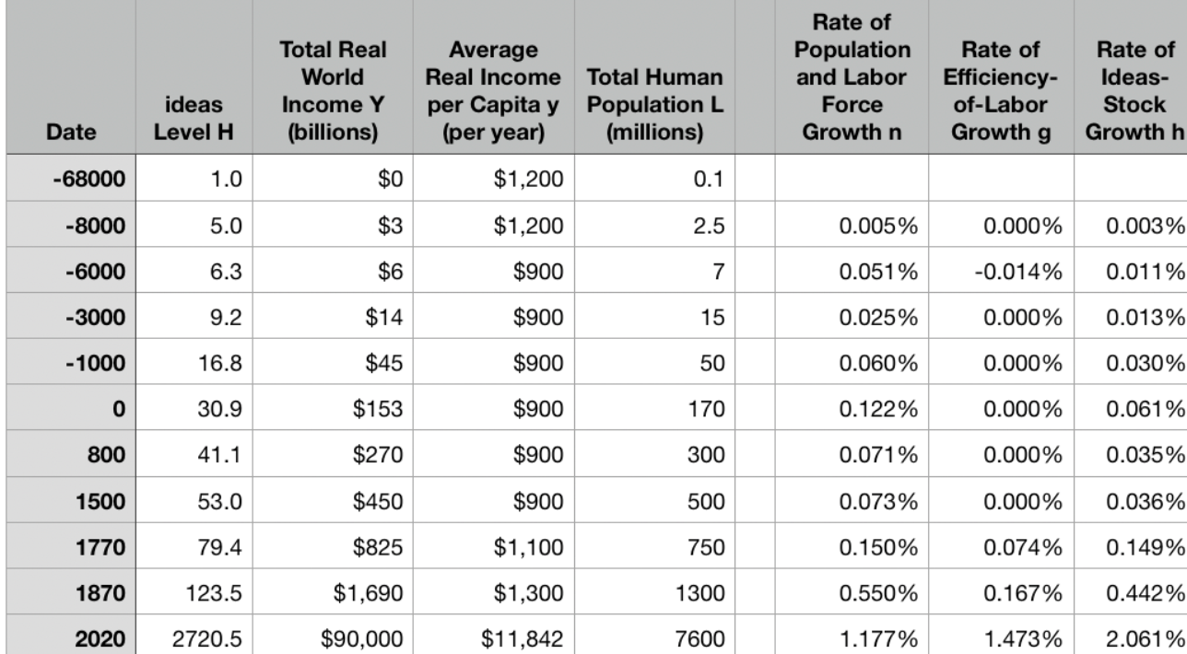
Review: Why Was Pre-Industrial Progress so Slow on Average?
Our readings:
Willem M. Jongman (2007): Gibbon was Right: The Decline and Fall of the Roman Economy <https://delong.typepad.com/jongman-gibbon-was-right.pdf>
Peter Temin: The Roman Market Economy, Roman Growth <https://delong.typepad.com/files/temin-roman-growth.pdf>
Moses Finley: Technical Innovation and Economic Progress in the Ancient World <https://delong.typepad.com/finley-technical.pdf>
Josh Ober (2019): Agamemnon's Cluelessness, selections <https://delong.typepad.com/files/ober-agamemnon-selections.pdf>

Slide 74
Potential Points of View
What are the possibilities here?:
No puzzle—given how few heads they had, and given the absence of printing and the difficulty of controlled experiments, it is a miracle that they managed to advance technology as far as they did as fast as they did… (Kremer)
No: there was something wrong. They had the wrong kind of society… (Finley, critiqued by Ober)
No: something went wrong: civilization seems to be progressing up to the year 1… 0.013%/yr… 0.030%/yr… 0.061%/yr… & then it stalls out: instead of doubling to a Commercial Revolution rate of growth after the year 1, the rate of ideas growth halves again… (Jongman)

Slide 75
Our Four Readings
What possibilities do they argue for?:
Jongman:
“Population went down… production per man hour must have gone up…. The Roman Empire should have turned into a world of happy and prosperous peasants…. Reality was, of course, different… the emergence of a new social, political, and legal regime, where oppression replaces the entitlements of citizenship…”
Temin:
“The high ratio of wages to energy costs was not only absent in eighteenth-century continental Europe; it was absent as well in the Roman Empire…. There was no possibility of escaping from the Malthusian constraints… no possibility that industrialization could have begun in the ancient world…”
Finley:
“The pejorative judgments of ancient writers about labour, and specifically about the labour of the artisan, and of anyone who works for another, are too continuous, numerous, and unanimous, too wrapped up in discussions of every aspect of ancient life, to be dismissed as empty rhetoric. In other slave-owning societies for whom there is fuller documentation, these implications and their practical effects are unmistakable. Writing about the Great Trek, for example, Sir Keith Hancock said: 'The Boers very soon convinced themselves that artisans' work and slaves' work were the same thing—a conviction which struck such deep roots in their minds that their descendants in the nineteenth century left to British immigrants almost all the opportunities of skilled industrial employment in the expanding towns'. Or Tocqueville, whose I83I notebooks are filled with the theme that 'slavery is even more prejudicial to the masters than to the slaves', because, as a leading Louisville merchant said to him, 'it deprives us of the energy and spirit of enterprise that characterizes the States that have no slaves’…. Comparisons must be made with caution and reserve. But this particular one seems to me to be valid and necessary…”
Ober:
“Greeks were quite capable of the kind of reasoning necessary to build and sustain a growing economy…. Ancient Greeks, as individuals and collectives, frequently employed… rationally instrumental reasoning in economic contexts. It is nonetheless undeniable that there is a body of classical literature that exemplifies the scorn for money-making that was emphasized by the Finley school. Those expressions of scorn underpin the theory of an essentially timeless and changeless ancient economy predicated on violent extraction and gift exchange…. The approach of the Socratic philosophers to economic rationality was fundamentally critical and normative…. For Finley and his school… any activity that was not grounded in status, and in [its] power relations… was… unmoored and ephemeral…. Economic activity aimed at increasing productivity, innovations aimed at increasing efficiency, and increased consumption—rather than securing the status of the relevant actors—were, thereby, rendered more or less invisible—and in any event, unworthy of detailed study. The result was, so I suppose, both a misunderstanding of the relevant texts and a misrepresentation of the underlying social reality…”

Slide 76
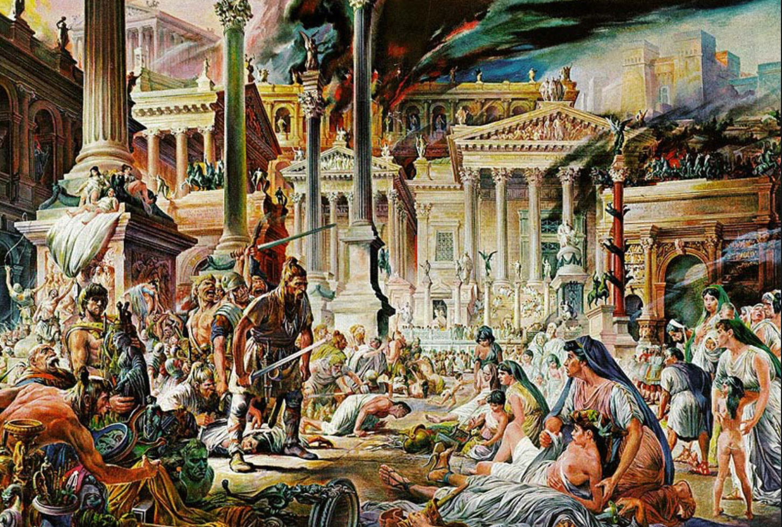
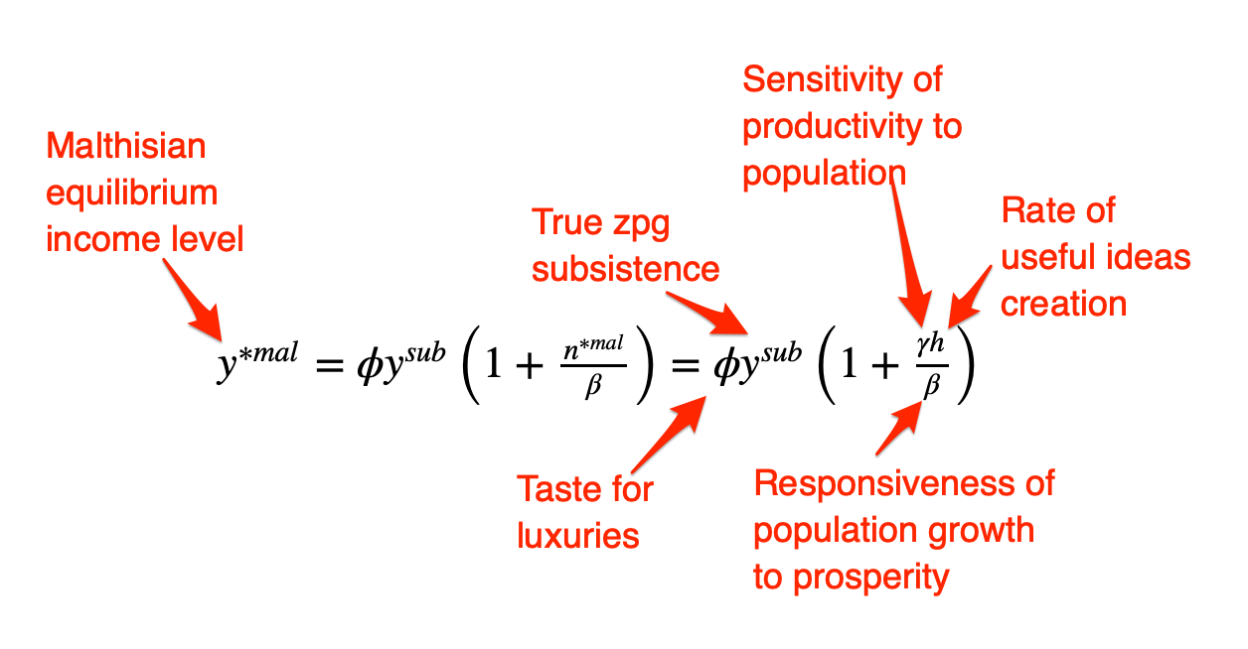
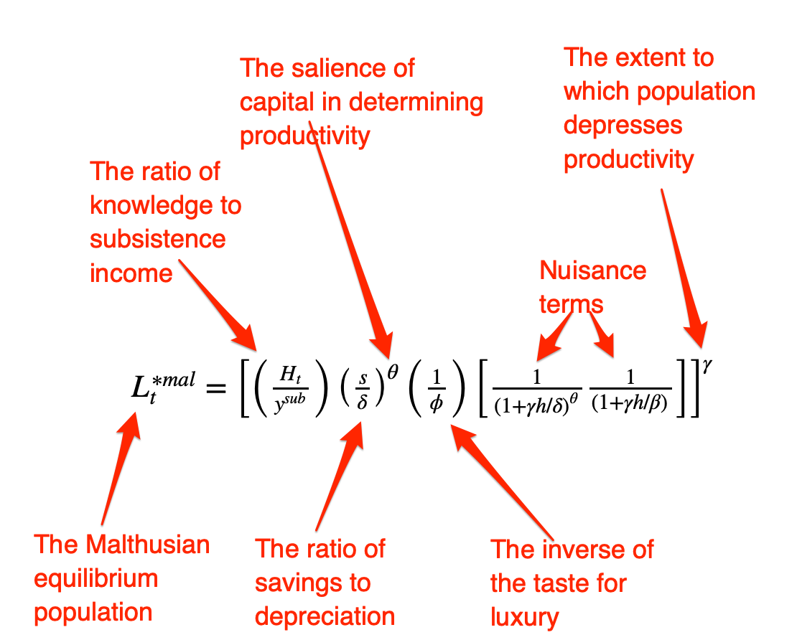
Review: The Fall of Rome
Economic Zenith, Then Economic Decline, Then Political Decline:
While the existing data are somewhat contradictory, the consensus amongst archaeologists is the early 2nd century.
A new social distinction between honestiores (high status) and humiliores (low status with different laws) was introduced.
Citizens began to lose their rights and by the end of the 2nd century, they were being tied to the land as serfs
The Barbarians were at the gates, but it seems reasonable to see this as an outcome of the weakening of Roman institutions
Earlier Rome had defeated far more formidable and better organized enemies like the Carthaginians.
Acemoglu and Robinson argue that the big fact about what preceded the decline is that political institutions moved in a much more extractive direction and this was followed by economic institutions.
Jongman (“Gibbon was Right”) proposes that the Antonine plague which hit the Roman Empire around 160AD is the most likely explanation for the collapse of Rome.
But Malthusian crises are supposed to increase living standards, not reduce them: so what is going on?
Slide taken from Melissa Dell

Slide 77
Three Great Plagues
But the demands of the empire for revenue and of the upper class for resources remain the same:
Antonine Plague (smallpox?): Antonine ⇒ Severian dynasty
Plague of St. Cyrian (Ebola-like?): Things fall completely apart, then Diocletian: between Philip the Arab and Diocletian, 18 emperors in 35 years, plus two breakaways; 12 of the 18 were assassinated
Plague of Justinian (Bubonic): Flavius Apion…

Slide 78
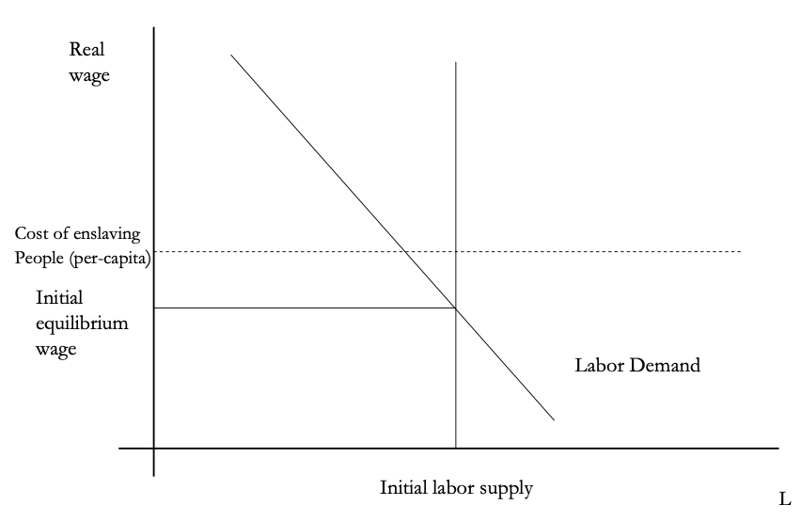
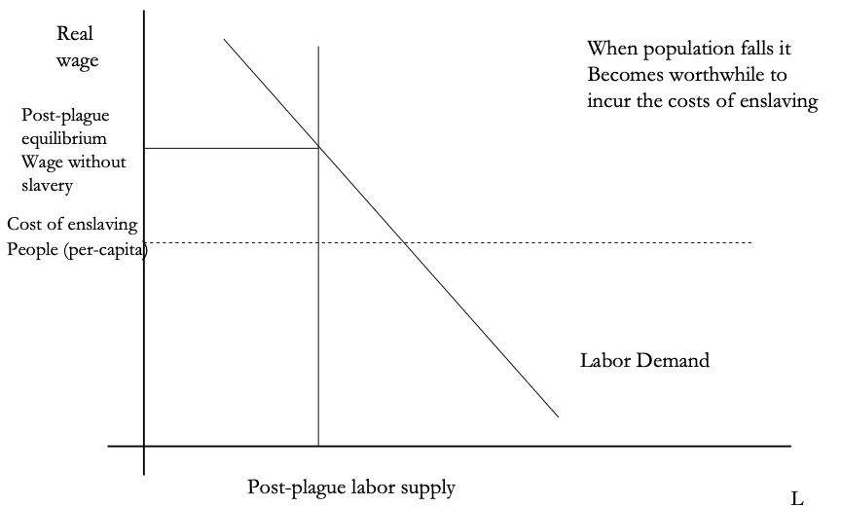
The Domar Hypothesis
You can have a leisured upper class, or abundant land relative to labor, or free labor, but not all three at once:
Slide taken from Melissa Dell

Slide 79
The Later Roman Empire
How does it compare to the expanding Roman Republic?
Militarism: in striking contrast to earlier days, a successful general is a threat to the emperor. Eighteen emperors in 35 years between Philip the Arab and Diocletian
Mobilization: In order to extract resources from a smaller population, the people must be disarmed rather than mobilized.
Distribution: The smaller pool of benefits needs to be hoarded for those with connections, not shared.
Incorporation: You can join the Goths: you cannot join the Roman upper class unless you know someone…

Slide 80
Dell’s Summary of Acemoglu and Robinson on the Rise and Fall of Rome II
For the Roman Empire, the collapse of Roman authority was pronounced, particularly in the West:
By 450AD all the trappings of Roman economic prosperity were gone.
Money vanished from circulation.
Urban areas were abandoned and buildings stripped of stone.
The roads were overgrown with weeds.
The only type of pottery which was fabricated was crude and hand made, not manufactured.
People forgot how to use mortar and they also forgot how to read and write.
Roofs were made of branches, not tiles.
The Eastern Roman Empire lived on, but it contracted significantly with the rise of Islam in the 7th Century.
Slide taken from Melissa Dell

Slide 81
Review: Republic to Empire
Political transition:
The expansion of Rome’s conquests created inequality and increasing political instability.
There were calls for the redistribution of land and power.
For example, Plebeian Tribune Tiberius Gracchus started to develop very ‘populist’ political platforms which threatened the senatorial elites.
The culmination of this was civil war, the dictatorship of Julius Caesar, and finally the creation of the Empire under Augustus.
First the principate
Then the dominate
Augustus reformed the army, removing it as a bastion of plebeian power.
His successor Tiberius stripped the assemblies of powers and gave them to the senate—and then neutered the senate
A semi-hereditary monarchy replaced the Republic:
“May good success attend the Roman senate and people and myself. I hereby adopt as my son Marcus Ulpius Nerva Traianus…”
This was a move towards more “extractive” political institutions and though it stabilized things for awhile, there was an eventual movement towards even more extractive economic institutions
Slide taken from Melissa Dell

Slide 82
Always Scribble, Scribble, Scribble! Eh! Mr. Gibbon?
Beste, Memorials:
The Duke of Gloucester, brother of King George III, permitted Mr. Gibbon to present to him the first volume of The History of the Decline and Fall of the Roman Empire. When the second volume of that work appeared, it was quite in order that it should be presented to His Royal Highness in like manner. The prince received the author with much good nature and affability, saying to him, as he laid the quarto on the table,
“Another damned thick, square book! Always, scribble, scribble, scribble! Eh! Mr. Gibbon?”

Slide 83
Always Scribble, Scribble, Scribble! Eh! Mr. Gibbon?
Five Good Emperors: Nerva-Trajan-Hadrian-Antonius Pius-Marcus Aurelius:
If a man were called to fix the period in the history of the world, during which the condition of the human race was most happy and prosperous, he would, without hesitation, name that which elapsed from the death of Domitian to the accession of Commodus.
The vast extent of the Roman empire was governed by absolute power, under the guidance of virtue and wisdom.
The armies were restrained by the firm but gentle hand of four successive emperors, whose characters and authority commanded involuntary respect.
The forms of the civil administration were carefully preserved by Nerva, Trajan, Hadrian, and the Antonines, who delighted in the image of liberty, and were pleased with considering themselves as the accountable ministers of the laws.
Such princes deserved the honor of restoring the republic, had the Romans of their days been capable of enjoying a rational freedom.
The labors of these monarchs were overpaid by
the immense reward that inseparably waited on their success;
by the honest pride of virtue, and
by the exquisite delight of beholding the general happiness of which they were the authors.

Slide 84
Aelius Aristides
The Roman Oration:
Whatever the seasons make grow and whatever countries and rivers and lakes and arts of Hellenes and non-Hellenes produce are brought from every land and sea, so that if one would look at all these things, he must needs behold them either by visiting the entire civilized world or by coming to this city. For whatever is grown and made among each people cannot fail to be here at all times and in abundance. And here the the merchant vessels come carrying these many products from all region in every season and even at every equinox, so that the city appears a kind of common emporium of the world.
Cargoes from India and, if you will, even from Arabia the Blest one can see in such numbers as to surmise that in those lands the trees will have been stripped bare and that the inhabitants of these lands, if they need anything, must come here and beg for a share of their own. Again one can see Babylonian garments and ornaments from the barbarian country beyond arriving in greater quantity and with more ease than if shippers from Naxos or from Cythnos, bearing something from those islands, had but to enter the port of Athens. Your farms are Egypt, Sicily and the civilized part of Africa.
Arrivals and departures by sea never cease, so that the wonder is not that the harbor has insufficient space for merchant vessels, but that even the sea has enough, if it really does.
And just as Hesiod said about the ends of the Ocean, that there is a common channel where all waters have one source and destination, so there is a common channel to Rome and all meet here, trade, shipping, agriculture, metallurgy, all the arts and crafts that are or ever have been, all the things that are engendered or or grow from the earth. And whatever one does not see here neither did nor does exist. And so it is not easy to which is greater, the superiority of this city in respect to the cities that now are or the superiority of this city respect to the empires that ever were…

Slide 85
Review: The Rise of Rome
Roman Institutions are key to the rise of Rome:
In 510BC, the citizens of Rome overthrew their king, Lucius Tarquinius Superbus, and created a republic.
The state was run by elected officials:
Two consuls who had the job for one year
Other magistrates: praetors, aediles, proconsuls
Tribunes.
Offices were elected, annual, and held by multiple people at the same time
This greatly reduced the ability of any one person to consolidate or exploit his power.
The institutions of the Republic contained a system of checks and balances which distributed power fairly widely.
Even if elite patrician families had far more power, it was possible for non-elites, so called plebeians, to get to the top, and they constrained the power of the elites.
Then some plebeian families become equally elite…
The nobiles
Roman assemblies:
Centuriate: 193 centuries on the basis of military organization, weighted toward the rich. Elects the magistrates, declares war and peace
Tribal: After 241 BC, 35 tribes on the basis of geographical location
Plebeian: Non-patricians, run by Tribunes
Senate
Roman institutions:
Legions
Phalanx
Manipular
Marian
Imperium
Provinciae
Proconsuls and propraetors
Slide taken from Melissa Dell

Slide 86
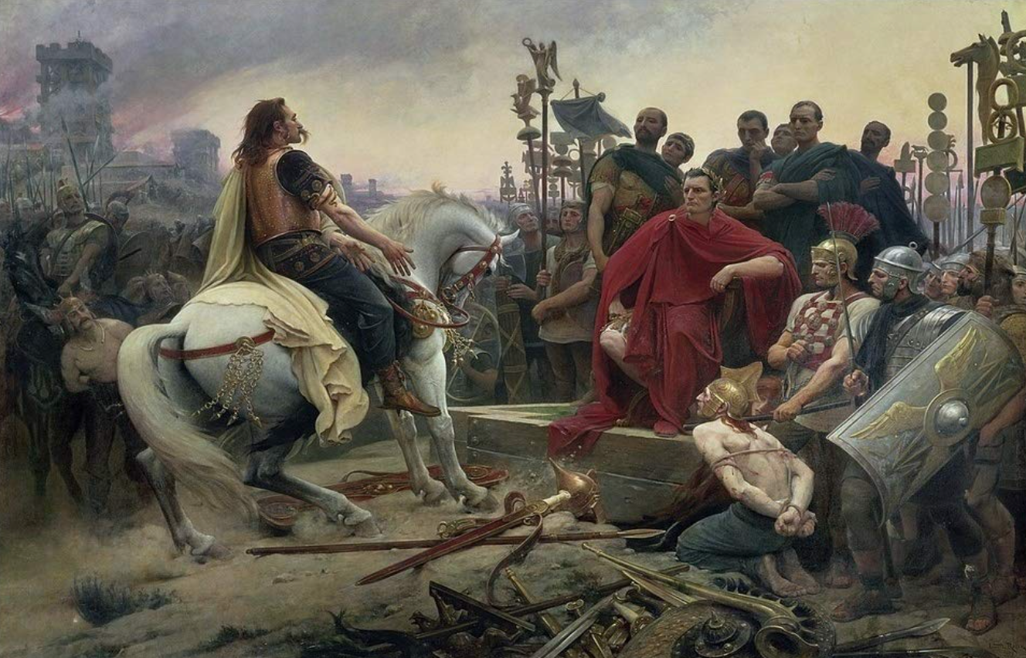
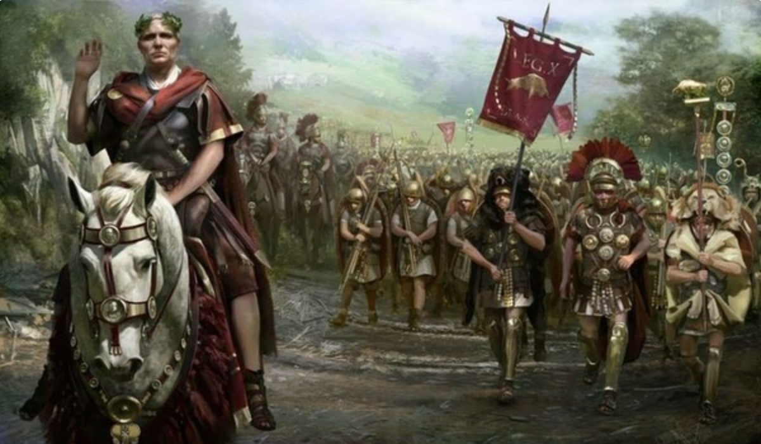
The Rise of Rome II
Roman Institutions are key to the rise of Rome:
Four key factors:
Militarism (on the part of elites competing for authority)
Mobilization (of the citizen mass)
Widely shared benefits (of conquest)
Incorporation (of conquered communities)
Mammoth military and political expansion after -340, and substantial economic, expansion
Slide taken from Melissa Dell

Slide 87
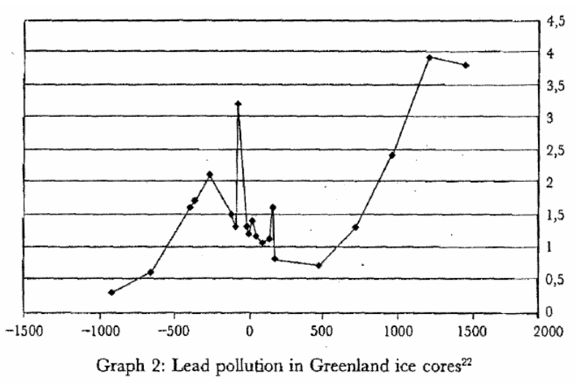



Measuring Roman Efflorescence
There are many interesting ways to track economic expansion:
Shipwrecks indicate trade, but they also track the movement of goods by fiat. For example, the citizens of Rome were kept happy by the free distribution of bread after 58BC. This was later extended to olive oil and even wine. This had to be shipped (mostly from Egypt and North Africa).
The Romans also moved around taxes levied in the provinces and supplied their troops. Some argue that 2/3 of all the ‘trade’ was actually the state moving stuff around.
For Roman citizens, economic institutions were quite good. However, the Italian economy was based on slavery (about 35% of the population of Italy were slaves at the time of the Emperor Augustus). There was little technological change.
Slide taken from Melissa Dell

Slide 88
Review: Pre-Industrial “Efflorescences”
Ideas courtesy of Jack Goldsmith, Daron Acemoglu and James Robinson:
The Malthusian model misses a great deal of the interesting action prior to the Industrial Revolution.
An alternative explanation for why there was no long-run trend in living standards is the theory of ‘efflorescence and decline’
I organize my thoughts about this with the two Malthusian equations, and with their bunch of variables and parameters: h, γ, β, φ, y^{sub}, s, δ, θ, and H that together determine y^{*mal} and L^{*mal}
This is best thought of as a filing system for factors that may be important—given the importance of both capital and labor efficiency, the roles of ideas and of resources in producing labor efficiency, and Malthusian population dynamics, these are the things you should look at

Slide 89


The Classical Greek Efflorescence
Emerging out of the Iron Dark Age of -1200 to -800:
When the Greek city states emerged they did so with functional systems of governance which provided public goods, such as security for trade and investment.
This initiated a period of sustained increases in living standards.
While Ancient Greece did have a period of democracy, it was relative short (less than 200 years) compared to the duration of the polity and most citizens - slaves, poor citizens who couldn’t afford their tax bill, women - could not participate.
Greek institutions (rules according to which the society was organized) tended to be “extractive.” For example, the economy was largely based upon slavery.
Slide taken from Melissa Dell

Slide 90


The Classical Greek Efflorescence II
“Developmental” or “Extractive”?
Extractive political institutions concentrate political power in the hands of some group who can use that power to redistribute wealth and income to themselves. This resulting concentration of wealth tends to reinforce the initial set of political institutions.
Roving bandits or stationary bandits?
Acemoglu and Robinson hypothesize that growth was not sustained in ancient societies because their institutions were extractive, and extractive institutions are incompatible with sustaining growth in the long run.
They argue that this is because extracting resources creates conflicts over who will control those resources, and it may also induce rebellion from below.
In either case political instability can bring the government and economy down.
Slide taken from Melissa Dell

Slide 91


The Anti-Kythera Mechanism
What is this?
Built between -150 and -70. Rhodes13” x 7” x 4“ wooden box
Gears—largest 5” in diameter
Inscriptions
Wikipedia: “37 gear wheels enabling it to follow the movements of the Moon and the Sun through the zodiac, to predict eclipses and even to model the irregular orbit of the Moon, where the Moon's velocity is higher in its perigee than in its apogee. This motion was studied in the 2nd century BC by astronomer Hipparchus of Rhodes, and it is speculated that he may have been consulted in the machine's construction. The knowledge of this technology was lost at some point in antiquity. Similar technological works later appeared in the medieval Byzantine and Islamic worlds, but works with similar complexity did not appear again until the development of mechanical astronomical clocks in Europe in the fourteenth century…”

Slide 92
The Anti-Kythera Mechanism II
What is this?
Brian Resnick: “A main gear would move to represent the calendar year, and would, in turn, move many separate smaller gears to represent the motions of the planets, sun, and moon. So you could set the main gear to the calendar date and get approximations for where those celestial objects would be in the sky on that date…. You, as a user, could input a few simple variables and it would yield a flurry of complicated mathematical calculations.… All the user had to do was enter the main date on one gear, and through a series of subsequent gear turns, the mechanism could calculate things like the angle of the sun crossing the sky. (For some reference, mechanical calculators—which used gear ratios to add and subtract—didn’t arrive in Europe until the 1600s)…”

Slide 93
Cicero (-54): De Re Publica
“With the exception of the dream of Scipio, in the last book, the whole treatise was lost till the year 1822, when the librarian of the Vatican discovered a portion of them among the palimpsests in that library. What he discovered is translated here; but it is in a most imperfect and mutilated state. The form selected was that of a dialogue, in imitation of those of Plato…”
I.XIV:
Then Philus said: “I am not about to bring you anything new, or anything which has been thought over or discovered by me myself. But I recollect that Caius Sulpicius Gallus, who was a man of profound learning, as you are aware, when this same thing was reported to have taken place in his time, while he was staying in the house of Marcus Marcellus, who had been his colleague in the consulship, asked to see a celestial globe which Marcellus’s grandfather had saved after the capture of Syracuse from that magnificent and opulent city, without bringing to his own home any other memorial out of so great a booty; which I had often heard mentioned on account of the great fame of Archimedes; but its appearance, however, did not seem to me particularly striking. For that other is more elegant in form, and more generally known, which was made by the same Archimedes, and deposited by the same Marcellus in the Temple of Virtue at Rome.
“But as soon as Gallus had begun to explain, in a most scientific manner, the principle of this machine, I felt that the Sicilian geometrician must have possessed a genius superior to anything we usually conceive to belong to our nature. For Gallus assured us that that other solid and compact globe was a very ancient invention, and that the first model had been originally made by Thales of Miletus. That afterward Eudoxus of Cnidus, a disciple of Plato, had traced on its surface the stars that appear in the sky, and that many years subsequently, borrowing from Eudoxus this beautiful design and representation, Aratus had illustrated it in his verses, not by any science of astronomy, but by the ornament of poetic description. He added that the figure of the globe, which displayed the motions of the sun and moon, and the five planets, or wandering stars, could not be represented by the primitive solid globe; and that in this the invention of Archimedes was admirable, because he had calculated how a single revolution should maintain unequal and diversified progressions in dissimilar motions.
“In fact, when Gallus moved this globe, we observed that the moon succeeded the sun by as many turns of the wheel in the machine as days in the heavens. From whence it resulted that the progress of the sun was marked as in the heavens, and that the moon touched the point where she is obscured by the earth’s shadow at the instant the sun appears opposite….
Scipio: “I had myself a great affection for this Gallus, and I know that he was very much beloved and esteemed by my father Paulus. I recollect that when I was very young, when my father, as consul, commanded in Macedonia, and we were in the camp, our army was seized with a pious terror, because suddenly, in a clear night, the bright and full moon became eclipsed. And Gallus, who was then our lieutenant, the year before that in which he was elected consul, hesitated not, next morning, to state in the camp that it was no prodigy, and that the phenomenon which had then appeared would always appear at certain periods, when the sun was so placed that he could not affect the moon with his light…”

Slide 94



Review: Class and Conflict: at the End of the Middle Ages, Elsewhere, and Elsewhere
What was “feudalism” and how did it end?
Marc Bloch’s definitions:
A subject peasantry
Widespread use of the service tenement (i.e., the fief) instead of a salary (or of private property plus taxation and then purchase)
The supremacy of a caste of specialized warriors
Ties of obedience and protection which bind man to man
Within the warrior class, these ties assume the distinctive form called vassalage
Fragmentation of authority
Disorder and private war
But also, other forms of association, family, and state surviving…
By the late Middle Ages feudalism was a stable system
Trade and population expanded
What data we have shows the number and size of cities increasing
Slide taken from Melissa Dell

Slide 95
A Four-Cornered Fight
Kings, Lords, Commons, & Peasants:
Class alliances, class power, and class conflict…
Plus ideological legitimations…
Friedrich Engels: “Exceptional periods, however, occur when the warring classes are so nearly equal in forces that the state power, as apparent mediator, acquires for the moment a certain independence in relation to both. This applies to the absolute monarchy of the seventeenth and eighteenth centuries, which balances the nobility and the bourgeoisie against one another; and to the Bonapartism of the First and particularly of the Second French Empire, which played off the proletariat against the bourgeoisie and the bourgeoisie against the proletariat. The latest achievement in this line, in which ruler and ruled look equally comic, is the new German Empire of the Bismarckian nation; here the capitalists and the workers are balanced against one another and both of them fleeced for the benefit of the decayed Prussian cabbage Junker-squires…”
This is not just in exceptional periods…
The relative autonomy of the state is the rule, not the exception…

Slide 96



Review: Malthusian Models and Reality

Slide 97

Eastern Europe and the “Second Serfdom”
The percentage of people killed in Europe was similar across space:
After the plague, landlords in Eastern Europe started to take over large tracts of land and expand their holdings, which were already larger than those in Western Europe.
Towns were weaker and less populous and rather than becoming freer, workers began to see their already existing freedoms encroached on: the Domar hypothesis at work.
This contrasts with western Europe.
Effects became especially pronounced after 1500, when Western Europe began to demand the agricultural goods which the East produced.
Eastern landlords ratcheted up their control over the labor force to expand their production.
Mecklenberg: in 1500, peasants owed only a few days service a year; by 1600 this was three days/week; children had to work for the lord for free for several years.
In Hungary, landlords legislated one day a week of unpaid labor services for each worker. In 1550 this was raised to 2 days per week. By the end of the century it was 3 days. Serfs subject to these rules made up 90% of the rural population.
What was it that allowed the Spanish settlers in Mexico to keep wages so low, when in England after the Black Death the state had been incapable of enforcing the Statue of Laborers and stopping wages from rising?
William the Conqueror rewarded his army by providing them with parceled landholdings to prevent them from becoming powerful regional warlords (save for the “marcher lords” along the Scottish and Welsh borders).
Many landholders in close proximity created intense competitive pressures for labor in the wake of the Black Death.
Slide taken from Melissa Dell

Slide 98

Is Malthus Right? II
At the macro level, yes; but there are lots of interesting meso- and small-scale puzzles:
In addition, measures of good government, such as proxies for constraints on the executive, are correlated with urbanization in this period.
For example, DeLong and Shleifer (1993) showed there was a strong correlation between form of government and urbanization in the pre-modern world
Charles Wilson (1967): Trade, Society, and the State: "The two areas which in 1500 represented the richest and most advanced concentrations of trade, industry and wealth were the quadrilateral formed by the Italian cities Milan, Venice, Florence and Genoa; and the strip of the Netherlands that ran from Ypres north-east past Ghent and Bruges up to Antwerp. It was not merely coincidence that these were the areas where the tradesmen of the cities had been most successful in emancipating themselves from feudal interference and in keeping at bay the newer threat of more centralized political control offered by the new monarchies. In the fleeting intervals between the storms of politics and war, men here glimpsed the material advance that was possible when tradesmen were left in peace unflattered by the attentions of strategists who regarded their activities as the sinews of war…”
Slide taken from Melissa Dell

Slide 99
Malthus: Summing Up
On the broadest scale only:
The simple Malthusian model may indeed capture some realities.
If labor markets are competitive, population growth may indeed induce a decline in wages.
Or if there is a fixed amount of land and few opportunities for labor intensive cultivation systems, a population increase may lead to a decline in output per worker.
However, the reality is typically much more messy.
How wages respond to changes in income will depend on institutions.
Thus the overwhelming likelihood that institutional or cultural factors also shaped pre-modern growth
It was not simply being dictated by the Malthusian relationship between births, deaths, and income.
Slide taken from Melissa Dell

Slide 100

Review: “Subsistence”

Slide 101



“Bare-Bones”
From Clark & Allen:
"Manual workers”—70% of median, 50% of average income
In 1800: the English population in 1800 is a very rich pre-industrial population
70% of spending spent on food
30-40% grains
20% meat and dairy
“Bare-bones” subsistence
Cities: Malthus rules, but it takes centuries—and other things can and do happen

Slide 102




Review: Determinants of Technological and Organizational Progress
How do we make sense of the fact that technological and organizational progress was so slow back then and is so (relatively) rapid now?
Two heads are (almost) better than one
But that does not quite work
Add in additional drag from first picking low-hanging fruit
What causes the increase in Lstem?
What institutions make it profitable for nstem to be higher?
Plus:
Learning by doing
Productivity through embodiment
Technology transfer through contact

Slide 103
Review: Solow-Malthus Model Basics
How do we make sense of the fact that people were ingenious and inventive back before 1500, and yet standards of living did not increase?
Although population did increase—slowly
Other parts of the model
Balanced-growth equilibrium
Convergence to equilibrium
Lecture notes: <https://nbviewer.jupyter.org/github/braddelong/long-form-drafts/blob/master/solow-model-5-pre-industrial.ipynb>
datahub: <http://datahub.berkeley.edu/user-redirect/interact?account=braddelong&repo=long-form-drafts&branch=master&path=solow-model-5-pre-industrial.ipynb>

Slide 104
Understanding the Solow-Malthus Equilibrium: Population and Labor Force
Notes:

Slide 105
Understanding the Solow-Mathus Equilibrium: Prosperity
Notes:

Slide 106

Steady-State and Along the Transition Path
The fall of an empire:
<https://nbviewer.jupyter.org/github/braddelong/LS2019/blob/master/2019-10-14-Ancient_Economies.ipynb>
A decline in inequality, taste for luxuries, and taste for urban living: Δφ = -0.25
A decline in law-and-order that produces a sharp fall in the savings rate: Δs = -0.10

Slide 107





Review: Solow Model Basics
Lecture Notes: <https://www.bradford-delong.com/2020/01/lecture-notes-the-solow-growth-model-the-history-of-economic-growth-econ-135.html>

Slide 108

Solving the Model

Slide 109

Along the Balanced-Growth Path
Everything except κ—which is constant—grows at a constant proportional rate: either n, or g, or n+g;
Labor force L grows at n
Income per worker y and the efficiency of labor E grow at g
Total income Y and the capital stock K grow at n+g

Slide 110
Review: Long-Run Patterns: Global h, g, & n

Slide 111

Long-Run Patterns: “Western” h, g & n
Where does the “ρ” come from?
“Ghost acreage”—conquest and resource utilization (sugar islands, timberlands, cottonlands, etc.)
Cultural expansion—Australia, Canada, New Zealand, & U.S.; Spain & Italy & Scandinavia; plus Japan, Korea, Taiwan, Hong Kong, & Singapore

Slide 112

One Figure: A Great Divergence
10:20
From 1800 to 2018:
The dots start with a 3-1 spread in incomes and a 10-year spread in life expectancy.
All the arrows go up.
Some arrows—mostly those already to the right—go right fast.
Other arrows go right slowly.

Slide 113

China and India and America, 1800-1975
From 1800 to 1975:
Measured living standards and productivity levels improve fourteen-fold in the United States…
…& less than 30% in China & India…
…in spite of economic, transport, and cultural globalization…
This is crazy!
A “great divergence”
Not only were China & India relatively poor in 1800, they fell further behind thereafter

Slide 114

China and India and America, 1975–2018
From 1975-2018:
Measured living standards and productivity levels…
…54.9/25.9 = 2.12 in America…
…16.0/0.9 = 17.8 in China…
…6.9/1.2 = 5.8 in India…

Slide 115
Greg Clark Being Contrarian
There were lots of technological “revolutions” before the Industrial Revolution
But they all petered out because of low price-elasticity of demand
Coal-steam-cotton-machinery-textiles-rails were different
But even that was reaching limits to growth by 1870 or so…
The classic British Industrial Revolution more a comparative-advantage concentration of global manufacturing than true modern economic growth…

Slide 116
Karl Marx (1867): The Key is “Capitalism”—Market Economy Plus…
Karl Marx (1867), "The Secret of Primitive Capital Accumulation," Capital, Vol. 1, Part VIII, Chapters 26-32 http://tinyurl.com/dl20090112k
“We have seen how money is changed into capital; how through capital surplus-value is made, and from surplus-value more capital. But the accumulation of capital presupposes surplus-value; surplus-value presupposes capitalistic production; capitalistic production presupposes the pre-existence of considerable masses of capital and of labour power in the hands of producers of commodities. The whole movement, therefore, seems to turn in a vicious circle, out of which we can only get by supposing a primitive accumulation (previous accumulation of Adam Smith) preceding capitalistic accumulation; an accumulation not the result of the capitalistic mode of production, but its starting point…”
“The immediate producer, the labourer, could only dispose of his own person after he had ceased to be attached to the soil… the slave, serf, or bondsman of another. To become a free seller of labour power… he must further have escaped from the regime of the guilds…. The historical movement which changes the producers into wage-workers… their emancipation from serfdom and from the fetters of the guilds… alone exists for our bourgeois historians…”
“But… these new freedmen… [were also] robbed of all their own means of production, and of all the guarantees of existence afforded by the old feudal arrangements. And the history of this, their expropriation, is written in the annals of mankind in letters of blood and fire…”
Workers must work for wages…
Capitalists must invest and accumulate…

